Slide 1
Sharing the Beauty of Roses with Photos and Arrangements
Getting Started

Slide 2
“They are not long, the days of wine and roses”
Digital artwork
With Paris de Yves
St. Laurent as base photo

Slide 3
Getting Started with Photography
Presentation will focus on two of the basic elements of a good photograph: light and composition, then editing once the photo has been taken.
Difficult to discuss all technical aspects of photography since some use SLR or other cameras, others use cell phones; differences between Android and iPhones and generations of each.
May go without saying, but make sure before you get started that your batteries are charged and your lens is clean.
“The word ‘photography’ is a combination of the Greek root words ‘photo-,’ meaning ‘light,’ and ‘graphia,’ meaning ‘writing or drawing.’” From reference.com
IN TAKING YOUR PHOTOS, YOU ARE QUITE LITERALLY DRAWING WITH LIGHT

Slide 4
Photography and Light
True or False:
Since the sun is brightest in the middle of the day (around noon or so on a clear day), it is the best time of the day to take pictures.

Slide 5
Photography and Light
False:
Most people consider the early morning after sunrise or late afternoon (about an hour before sunset) as the best times for taking photos. This period is known as the “Golden Hour” when light is infused with more golden tones.

Slide 6
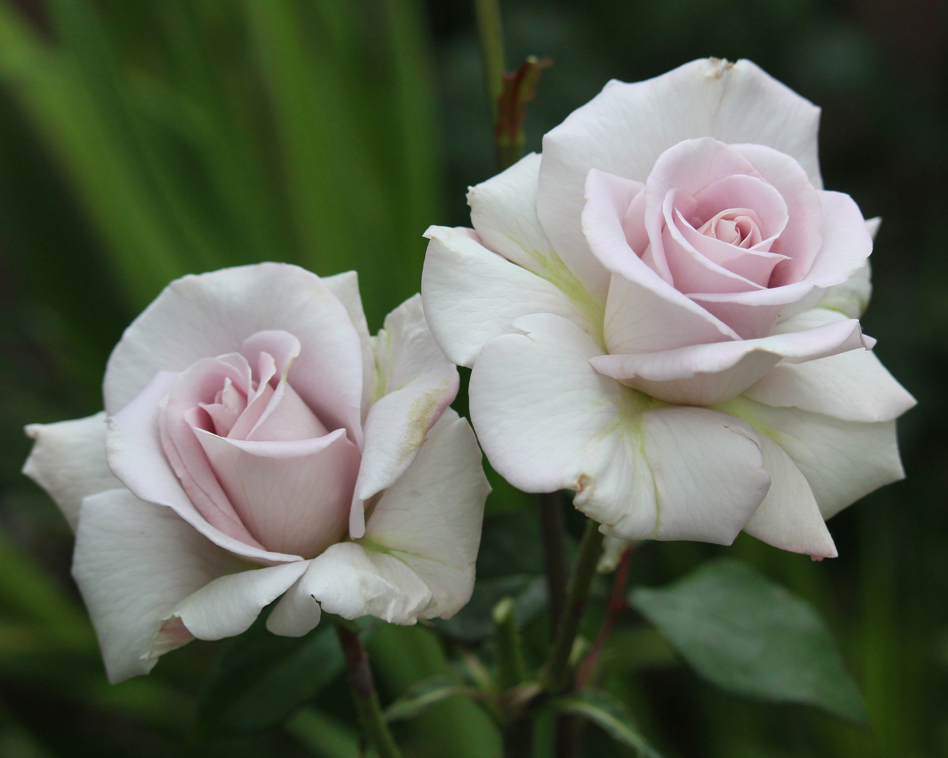
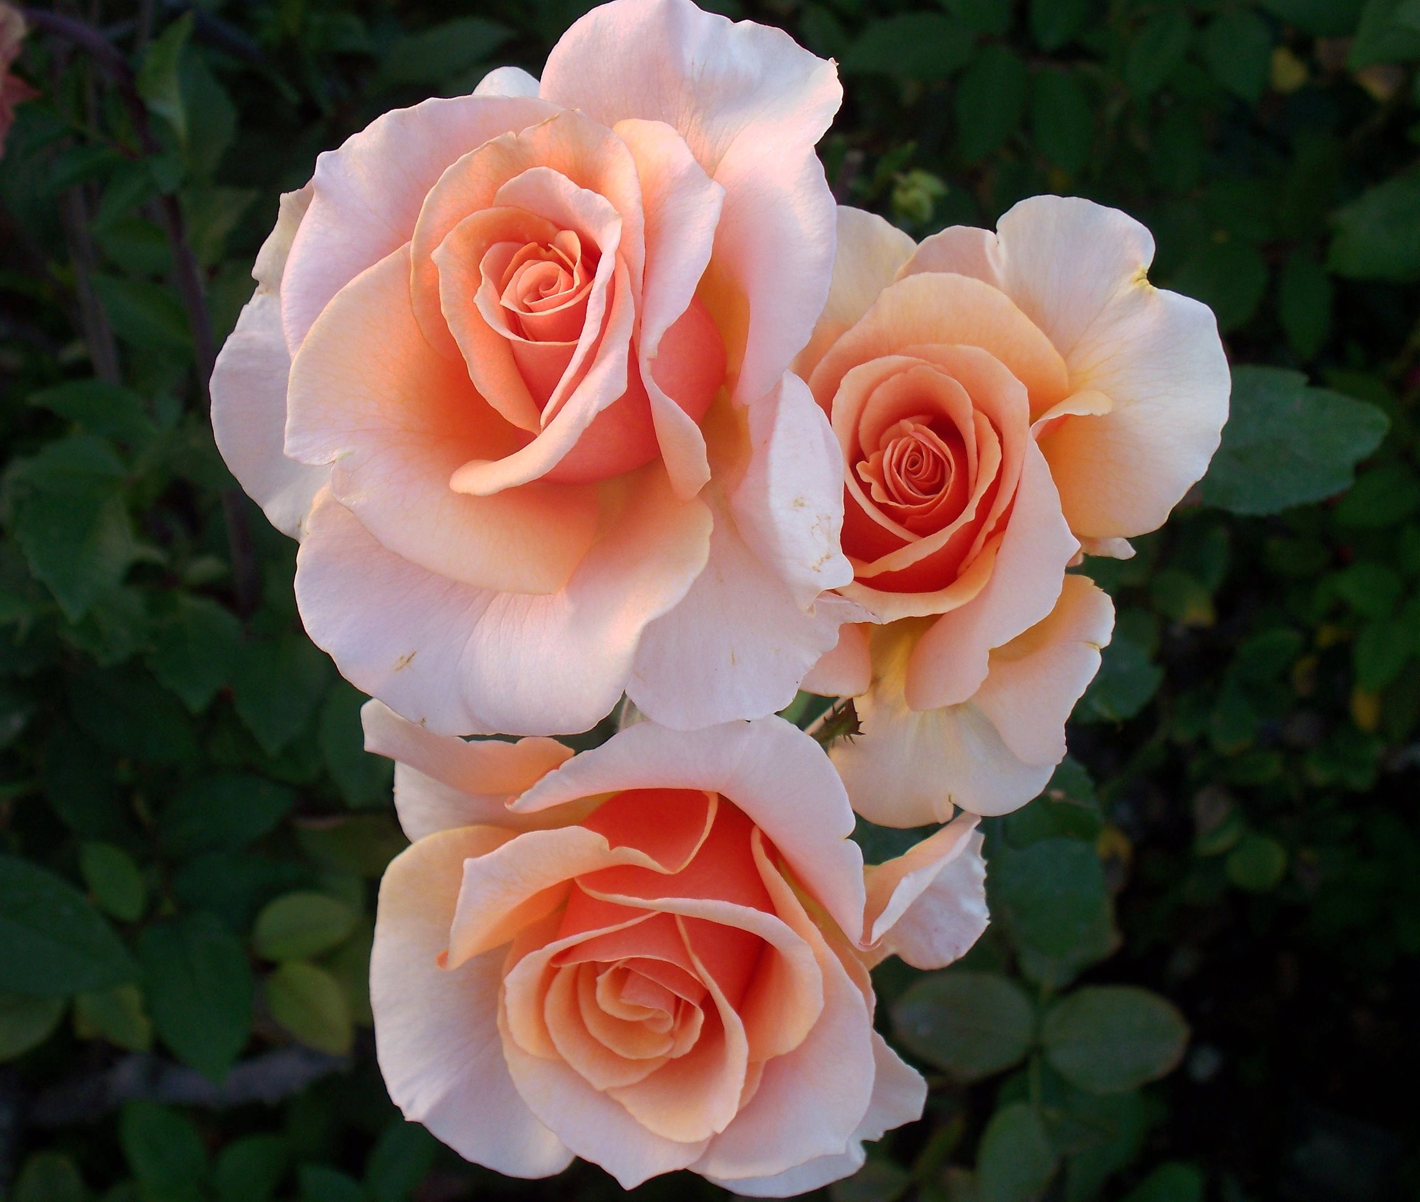
Photography and Light
Exercise #1: Look at your garden (or wherever you are taking pictures) and see what light is best for the plants at a particular time of day.
Above: Stainless Steel photo taken in the morning; at right: Brandy spray taken during Golden Hour

Slide 7
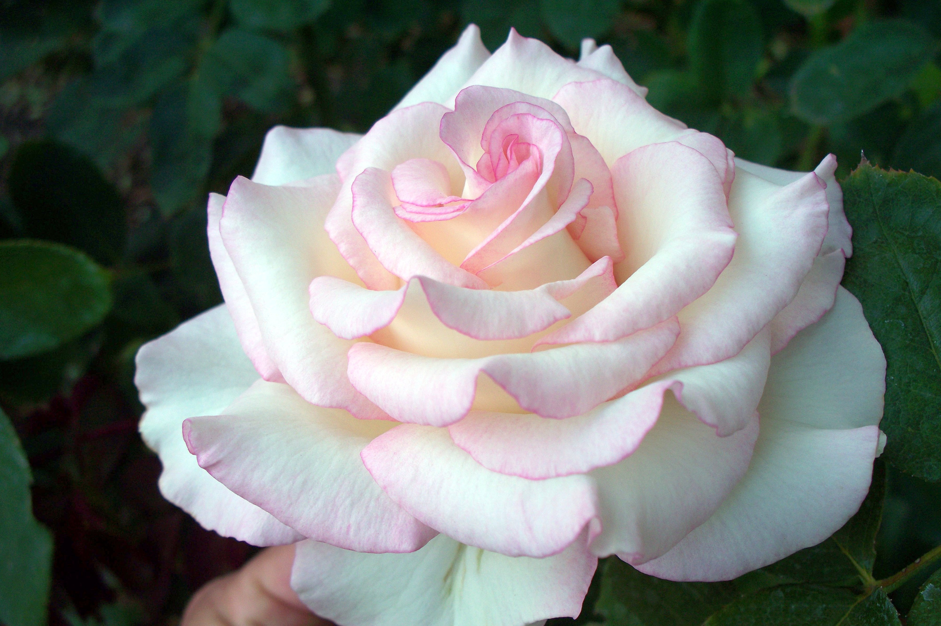
Photography and Light
Exercise #2: When your roses are in bloom, find a bloom you like. Take a photograph of it from the exact same angle in the early morning, mid-morning, noon, late afternoon/Golden Hour and close to sunset, then compare the photos. It is in this way that you begin to understand the relationship of light to the
pictures you have been and will be taking. Is a rose not growing where you want to photograph it? Cut it and take a picture of it elsewhere in the garden where the light is better.

Slide 8
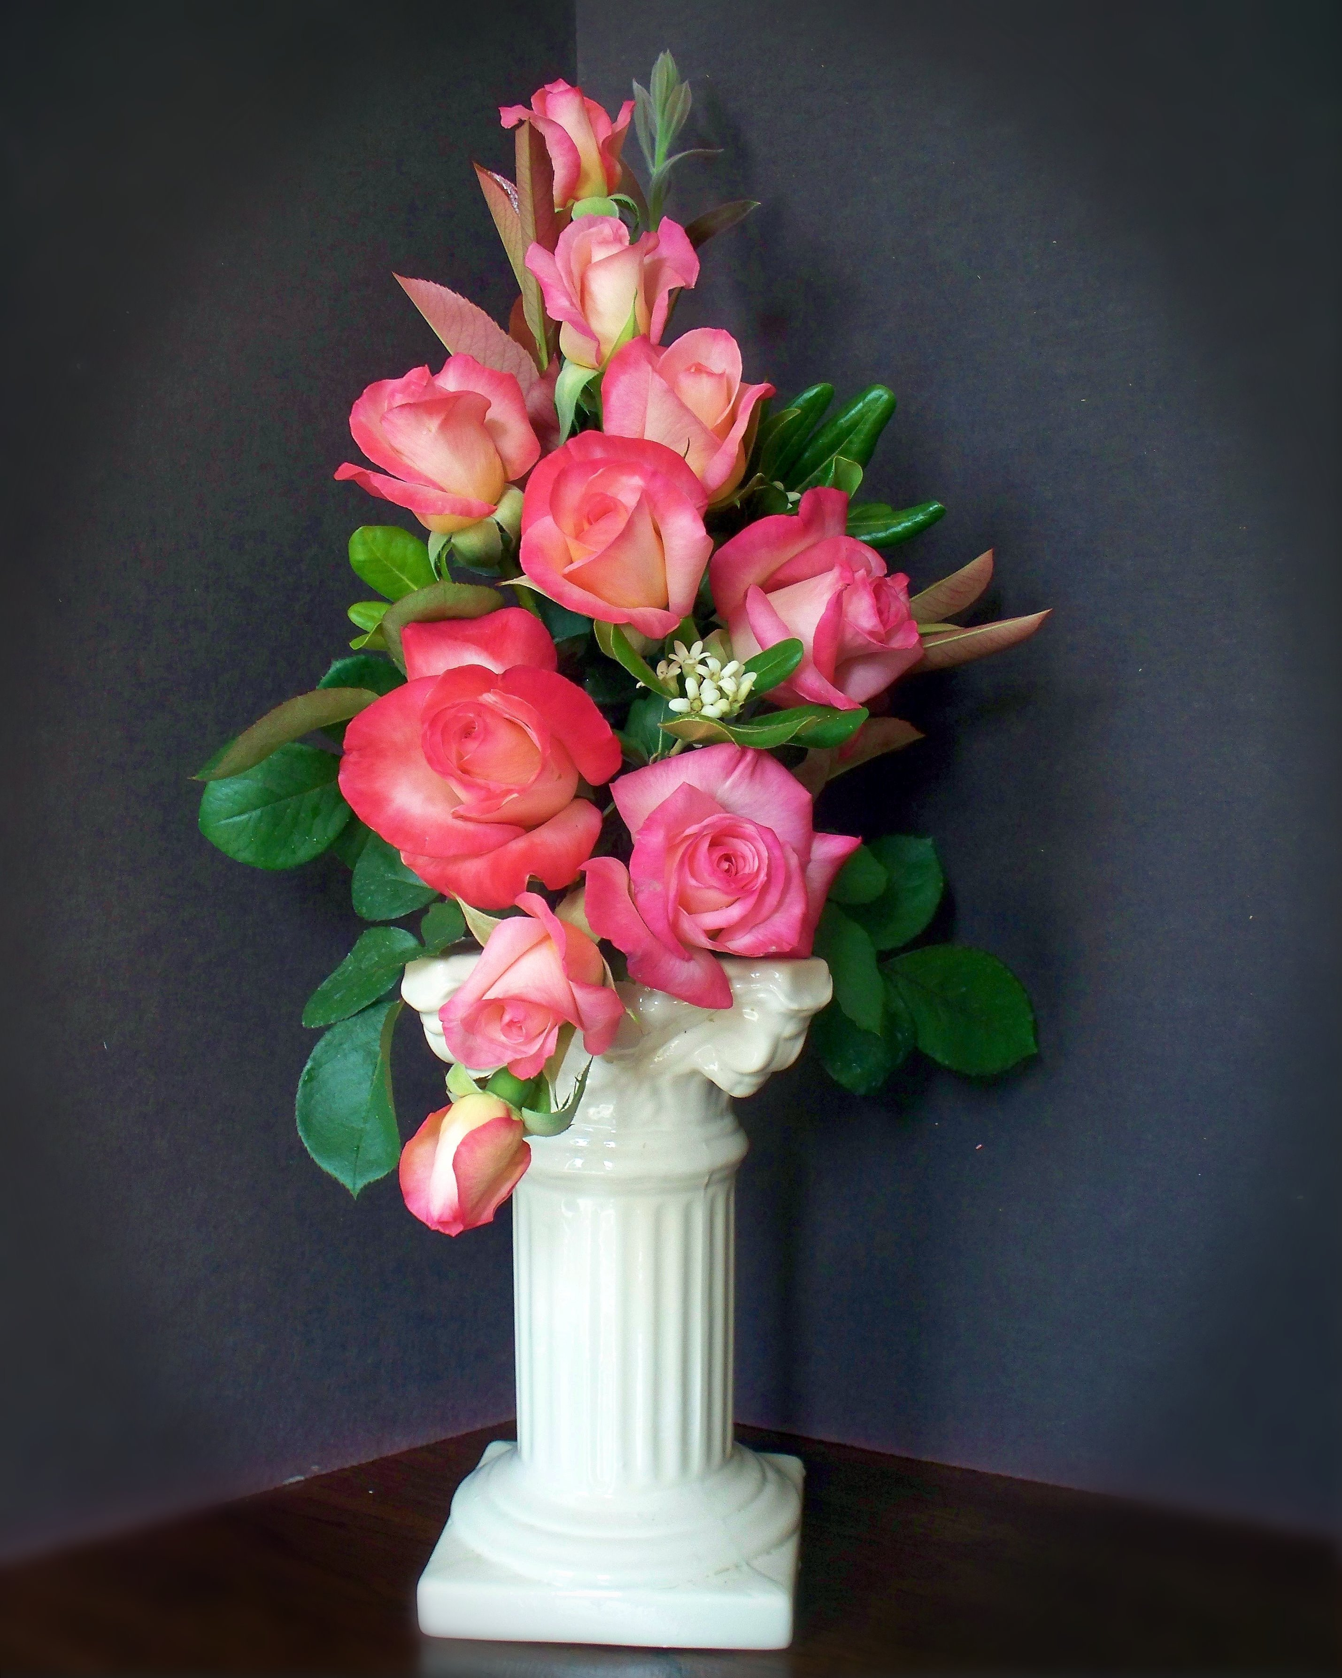
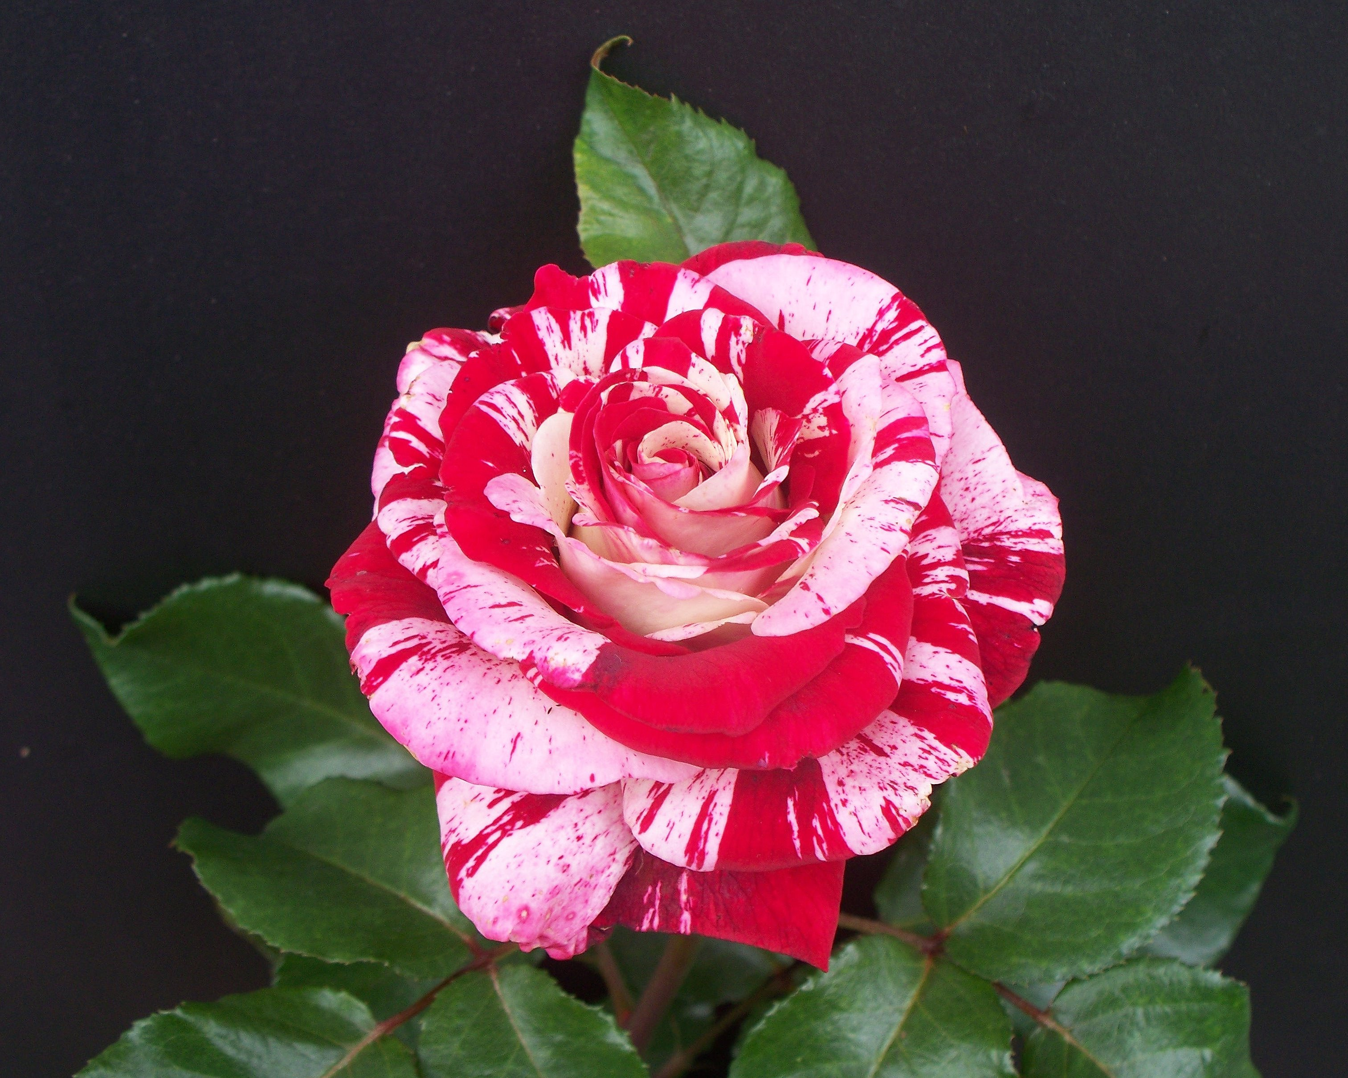
Photography and Light
Exercise #3: Don’t limit yourself to outdoor photos. Cut a rose and bring it inside. Take a photo next to a well-lit window. Try a photo with flash, though close-up flash in photographing roses can be harsh. Try photographing the bloom in a vase against one or more different backdrops.
Rock ‘N Roll against black poster board; HM in 2022 ARS national photo contest. Gemini arrangement against black backdrop; 1st place in 2022 ARS national photo contest.

Slide 9
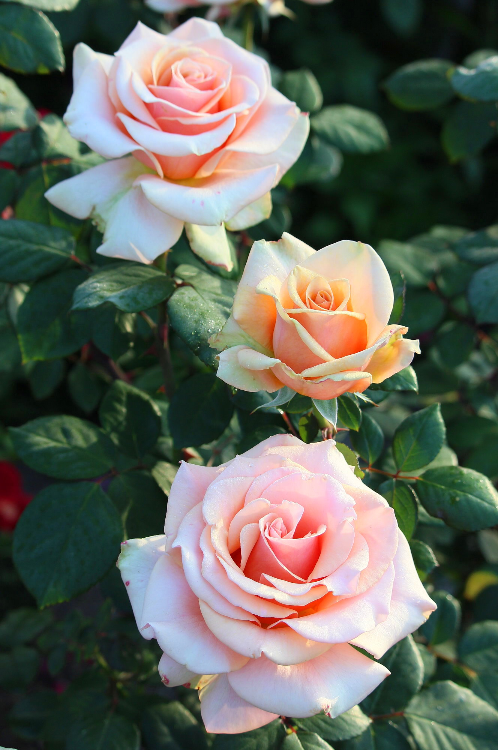
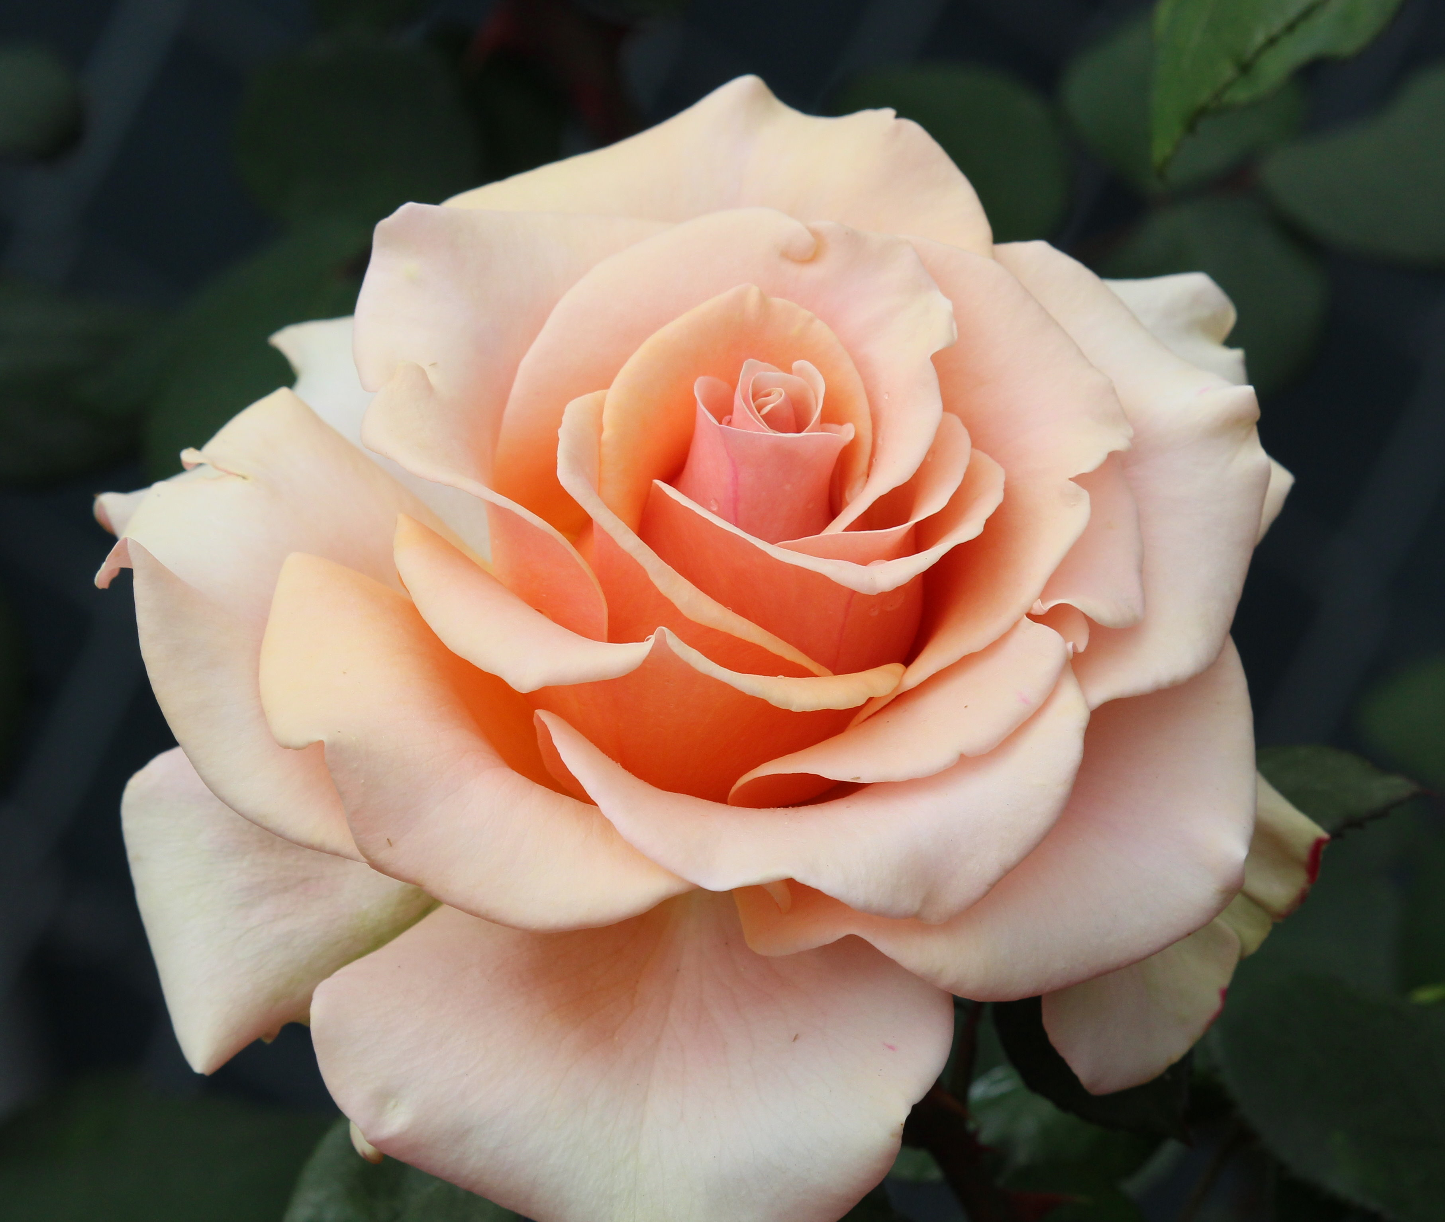
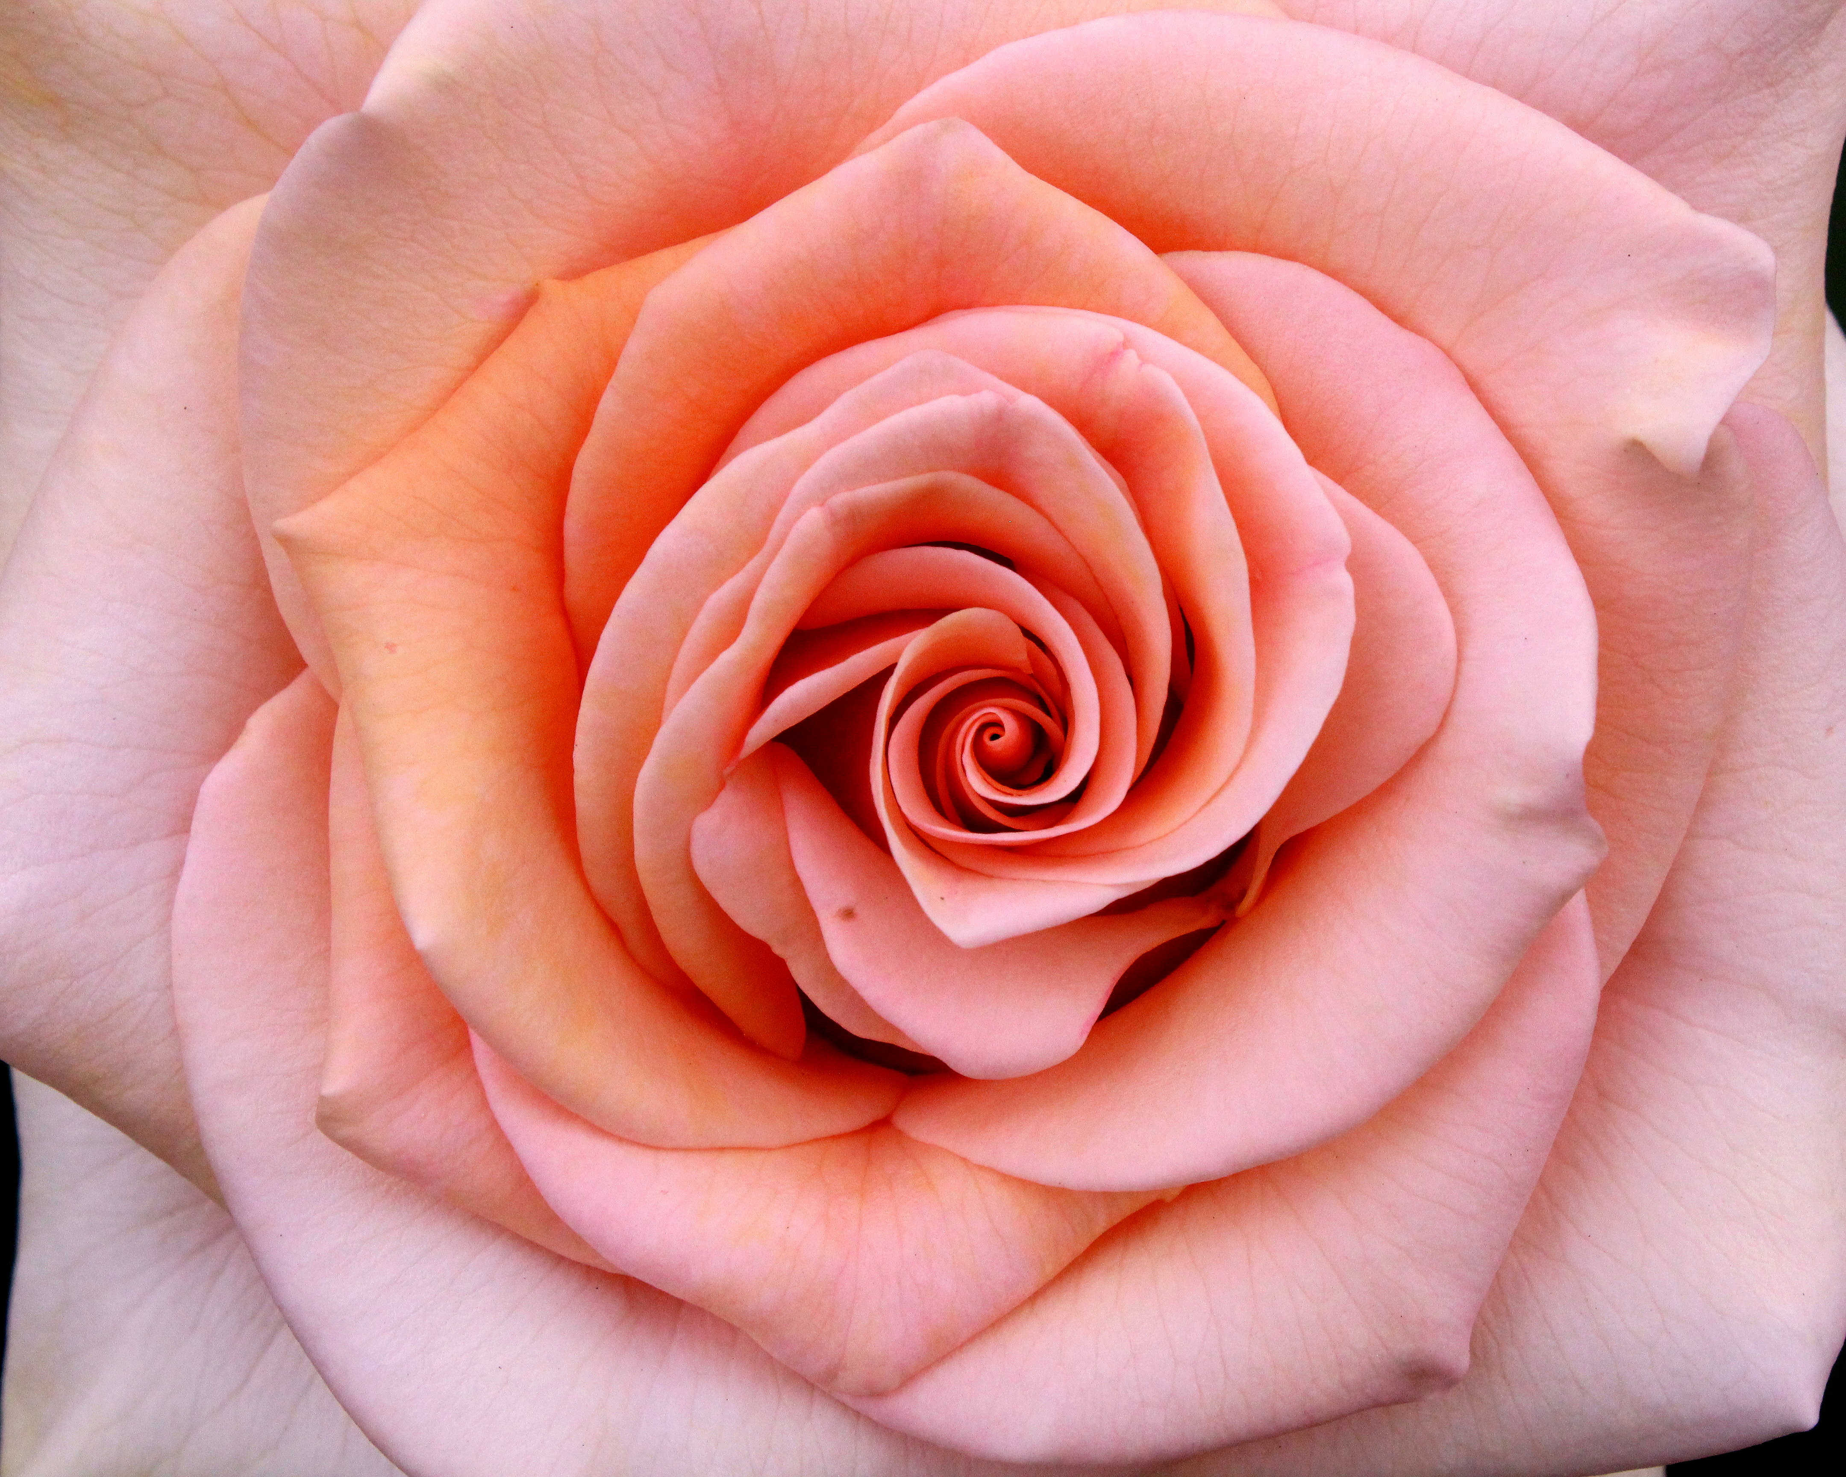
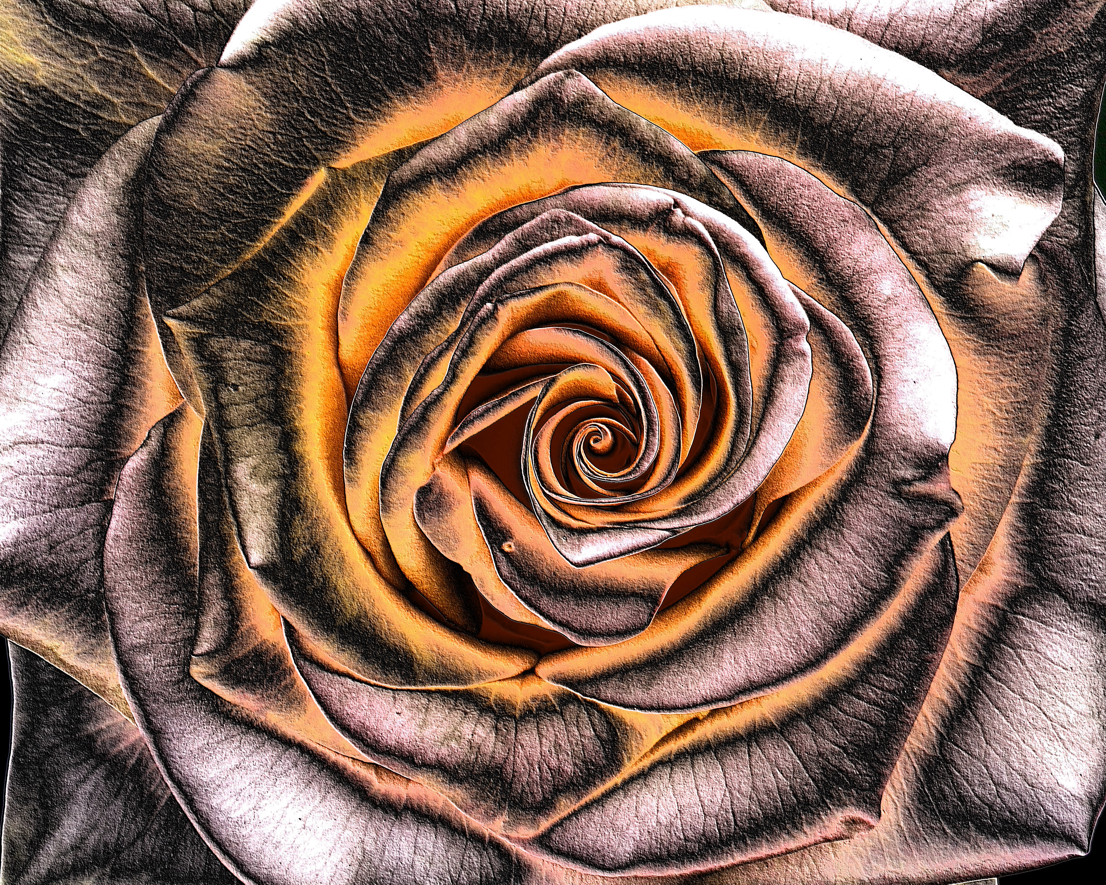
Photography and Composition
Composition was described by Dr. Susan Brandt Graham in a 2017 ARS presentation as “the arrangement of objects in a image to show rhythm or movement and guide the eye through the photograph.”
Do you want a shot that reflects a single rose/bloom or a spray, close-up or at a distance showing more of the plant? Begin thinking about that before taking the picture.
Your goal, particularly for a photo entered in a rose show, is to showcase the rose or part of the rose in its most outstanding form and most favorable light

Slide 10
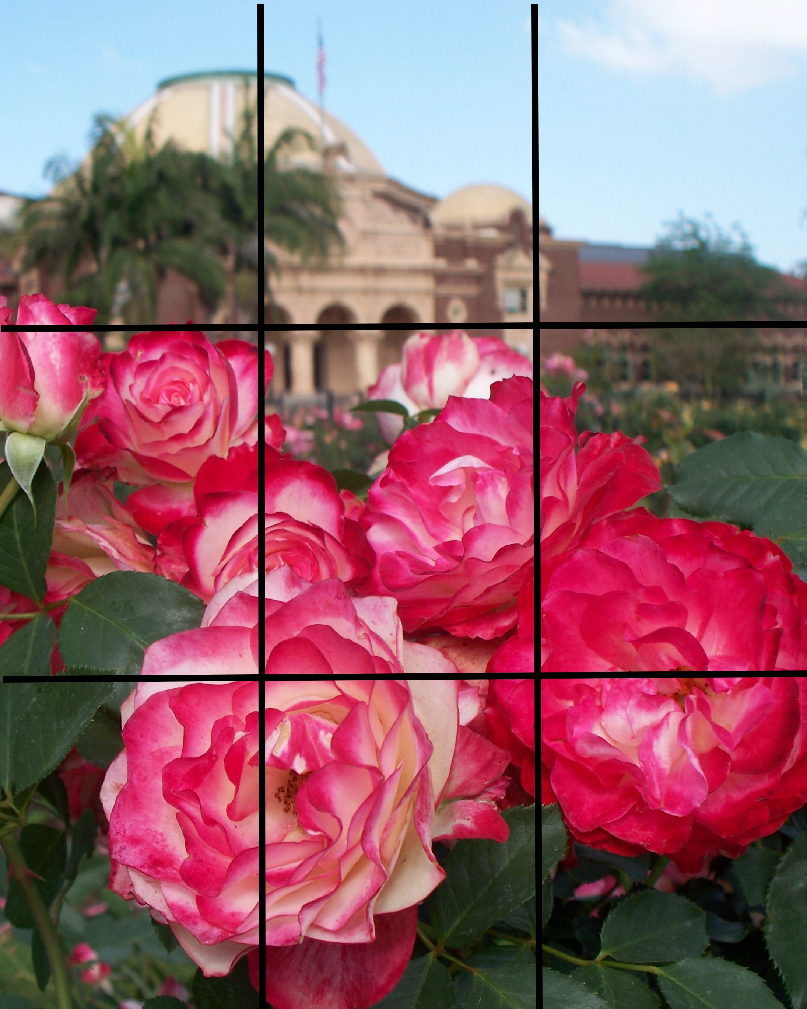
Photography and Composition
Rule of thirds in composing a photograph: In a grid with two equally-spaced horizontal and vertical lines, position main focal points along the gridline or with dominance in one third of the area. “Power points” are places where grid lines intersect. Decide what are the main points of interest in your photo and place them appropriately along the grid lines. Some cameras offer internal grid overlays in viewfinder. NOT the only rule or guideline, but helpful in starting to think about how to compose photos.

Slide 11
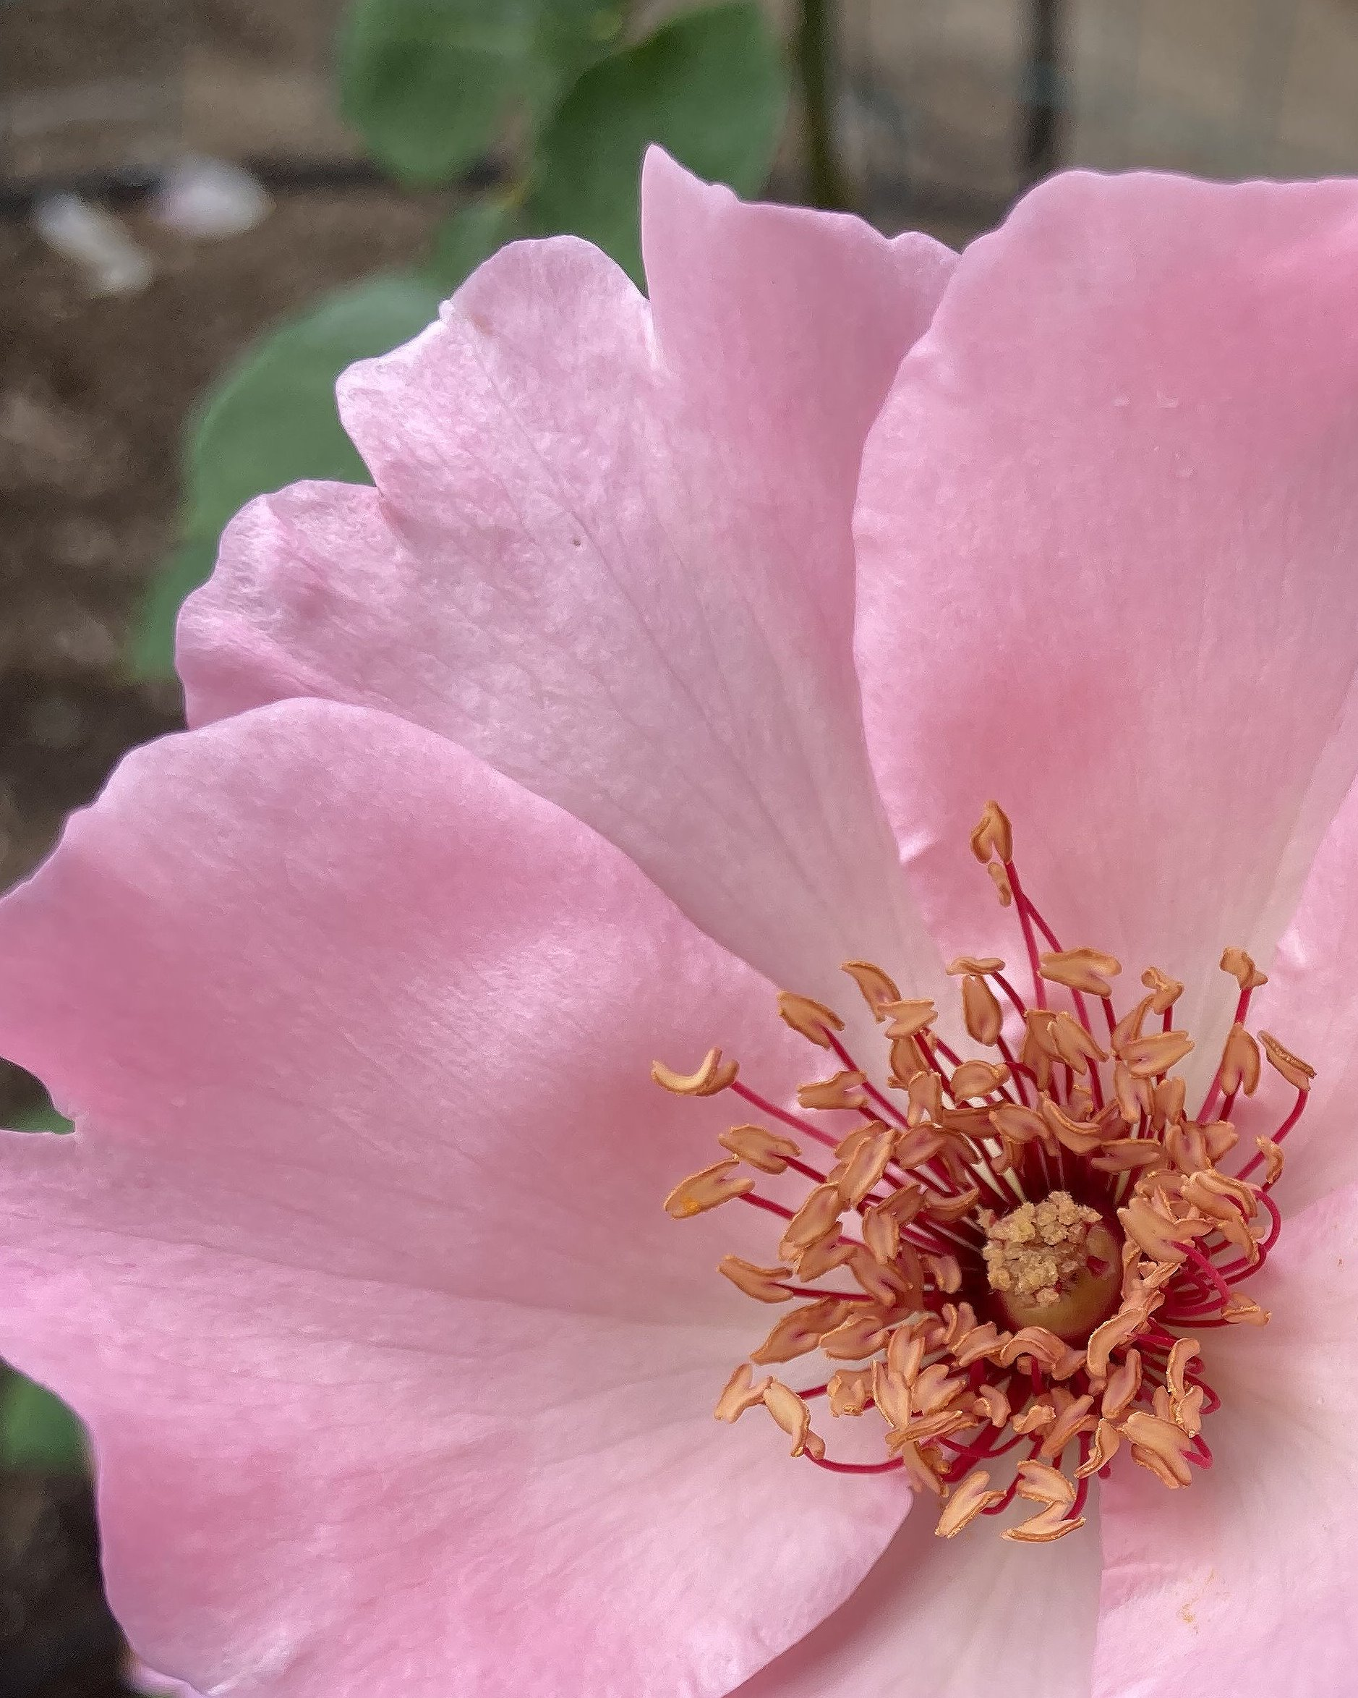
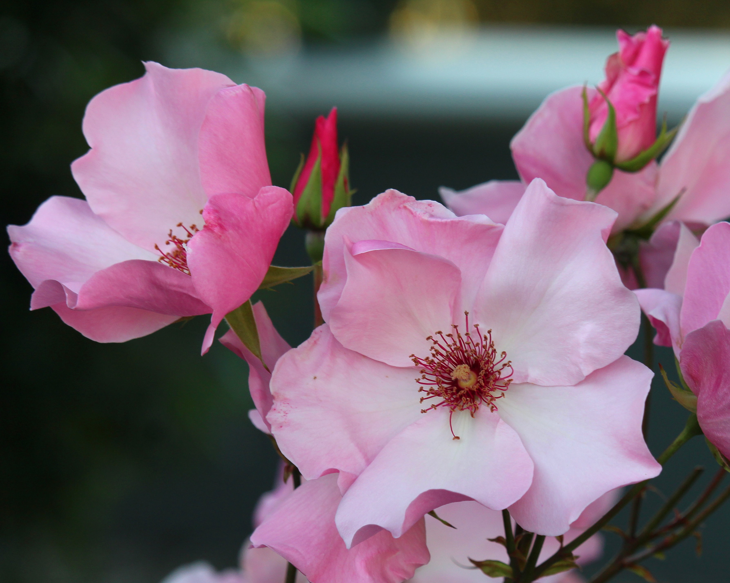
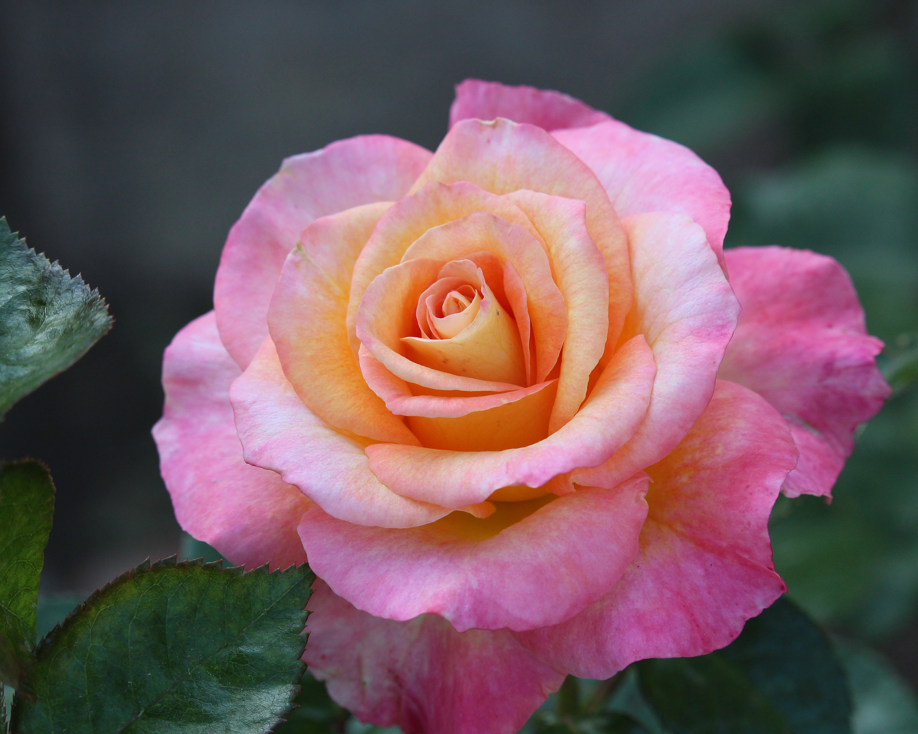
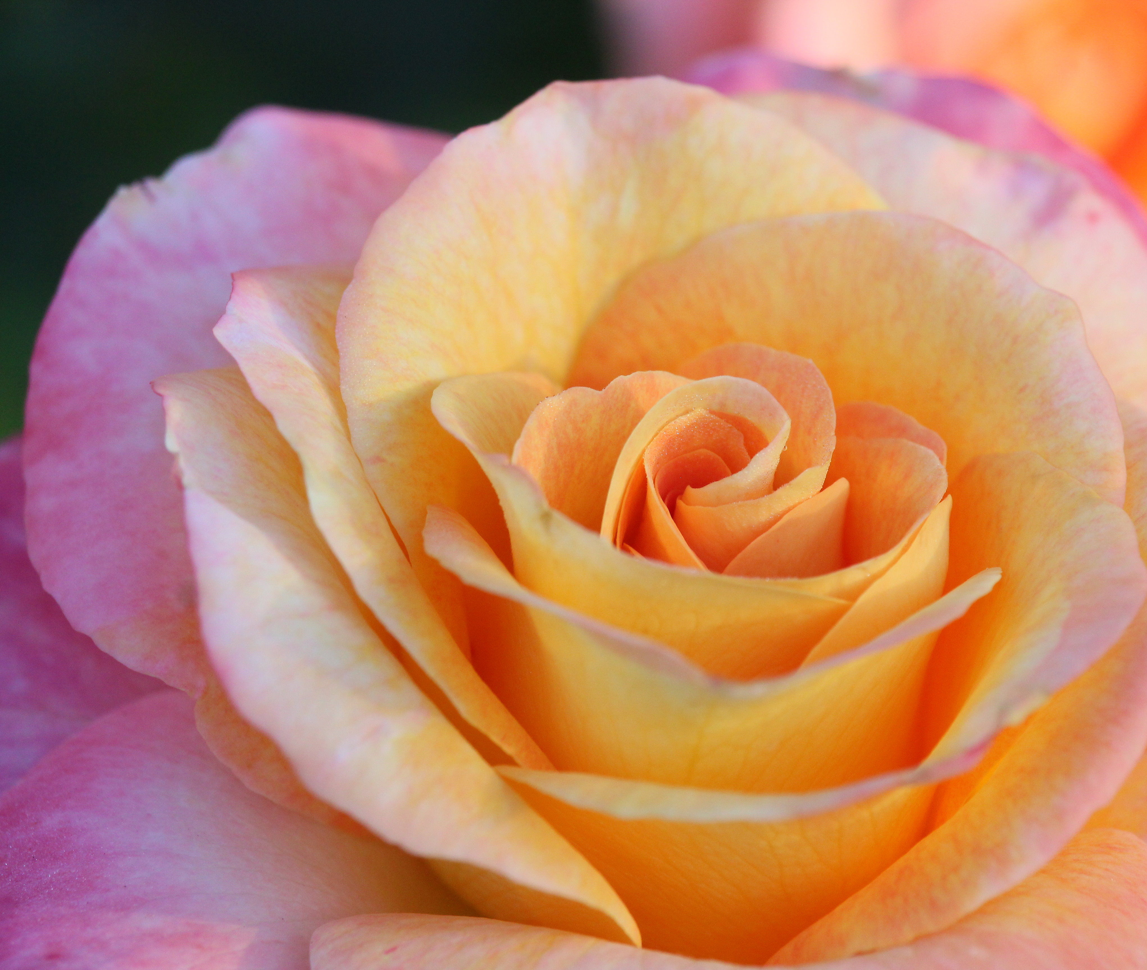
Photography and Composition
Exercise #4: Pick a particular bloom or spray at its peak. Take a picture of the bloom from several angles and at several distances – different sides, as a part of the larger bush, from the top, perhaps even from underneath. Think about where you are positioning the bloom in the viewfinder and composing the shot, then compare the photos you have taken.
Left: Dainty Bess, Right: Daybreaker

Slide 12
Editing Your Photos
Whether on a camera or cellphone, it is difficult to see all the details in a photo by simply looking at a small image.
When concentrating on the flower or flowers, you may miss an out-of-place stem, something in the background detracting from a photo or discolored or damaged leaves.
In my opinion, best review and editing of photographs is done on a larger screen, particularly on a computer.
PC Mag lists the following as the best photo editing software:
Adobe Lightroom and Adobe Lightroom Classic
Adobe Photoshop, Photoshop Elements (listed as best for hobbyists) and Photoshop Express (mobile Photoshop tools)
DxO PhotoLab
Corel PaintShop Pro (listed as best for budget-conscious editors)
Others include CyberLink Photo Director, Capture One Pro

Slide 13
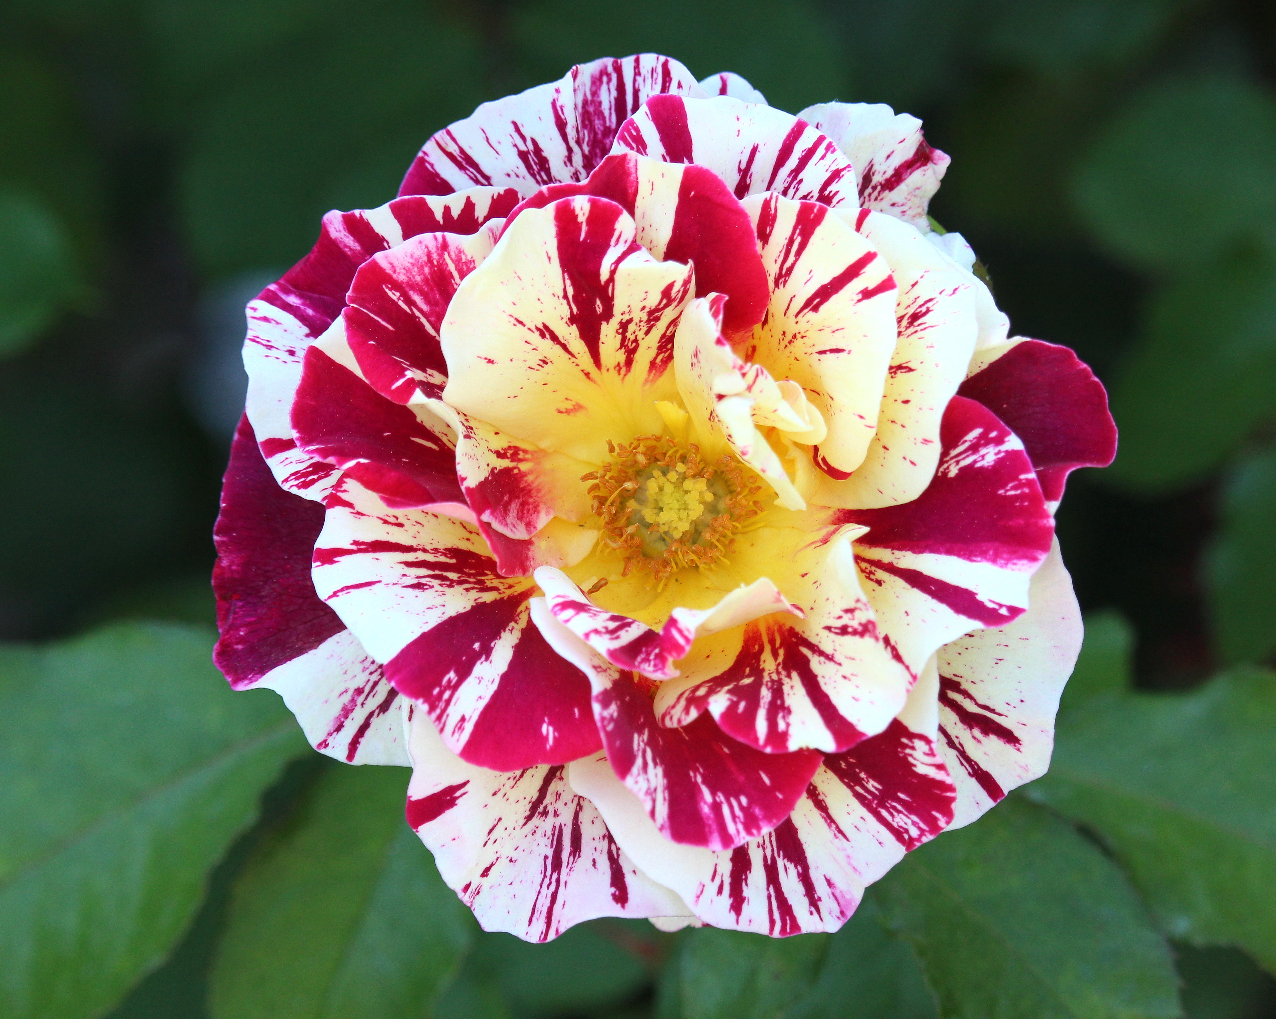
Editing Your Photos
You may need to use editing software to:
Crop an image (such as for an 8x10 photo). This also can be done at most commercial printing services such as Walgreens or Walmart, where you specify a size and are given an option for cropping the image
Fix the focus. An image should always be as crisp as possible
Remove unwanted elements in the picture
Fix color, contrast and other elements

Slide 14
Printing Photos and Other Thoughts
A frequent question: Where can I get my photos printed?
Check Walmart, Walgreens and CVS or camera stores
Costco no longer offers photo printing; the have shifted everything to Shutterfly
Always check to see if there is something in the process that says “Auto Correct” (or something similar). If you have used photo editing software to create a photo exactly as you would like it to be, be sure to uncheck “Auto Correct” or the printing machine may make changes to the image as it thinks it should be.
What can you do with your photos?
Make something for yourself or a friend with a service like Shutterfly.
ENTER YOUR PHOTOS IN A ROSE SHOW OR ARS COMPETITION!
Rose show photos must be matted at 11x14 inches; pay attention to the details in the program schedule on judging criteria and categories.

Slide 15
Getting Started with Arrangements
Disclaimer: Your speaker tonight has no formal training in floral arrangement but close to two decades of experience in arranging flowers for both ARS rose shows and the Orange County Fair.
Everyone puts roses in a vase, but think of how nice it would be to make arrangements for your own home and also to give to friends/family as gifts! And then . . . why not enter your arrangements in a show?
Be ready to put on many hats. In creating arrangements you will be:
Part rose/flower expert
Part artist
Part structural engineer
Part floral designer
Partly mystified (and sometimes frustrated), but that’s OK. Experience comes with practice and don’t be afraid to make mistakes.

Slide 16
Basic Equipment – Dried Arrangements
Roses or Other Flowers
Use buds or open flowers depending on your choice for arrangements
Open flowers should show form but not be too far open
Best colors of roses for drying: yellow and pink; some peach/orange
Flower will shrink in size when dried
Drying Medium
Air dry by hanging upside down in an area with good air circulation
Silica Gel and an airtight container
UV Floral Protectant Spray (once flowers are dried; some people say they use hairspray)
Airtight box for storage in cool, dark space (toss in a small silica packet from time to time)
Vase or container, small clippers for stems, and dry foam without water for arrangements

Slide 17
Basic Equipment – Fresh Arrangements
Flowers (Roses) and Filler (Greenery or Other Plant Material)
Know the characteristics of the rose(s) you want to use in an arrangement
Choose the appropriate rose and filler material for the type of arrangement you wish to make. To win awards in ARS shows, roses must be arranger-grown.
Good sources for filler: Your back yard, Trader Joe’s, grocery store (Ralphs/Albertsons), flower wholesalers, if any in your area
Container
Use a vase or other container appropriate for the type of arrangement (to be discussed in subsequent slides)
Support medium and other supplies
Floral foam (wet)
Pin frog(s)
Floral tape or wire
Small pruners or a floral knife for cutting stems

Slide 18
Arrangements and Judging Criteria ARS Rose Show Styles Judging Criteria
Traditional
Line
Line/Mass
Mass
East Asian Style
Low with water showing
Tall container
Freestyle
Modern (Variety of Styles)
Both full size and miniature arrangements
Conformance – 15 points
Design – 30 points
Perfection of the Rose – 30 points
Creativity and Expressiveness – 15 points
Distinction – 10 points
Roses must be the dominant feature of arrangements for ARS Rose Shows
For awards, all roses must be arranger-grown - “AG” indicated on entry tag

Slide 19
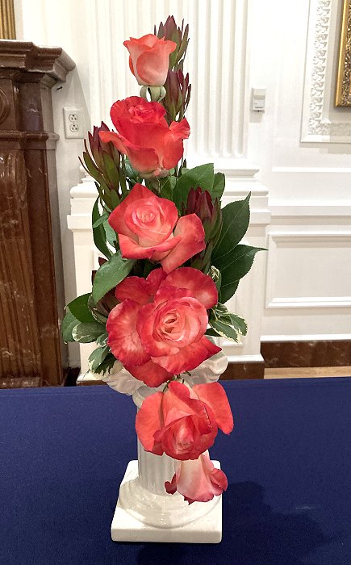
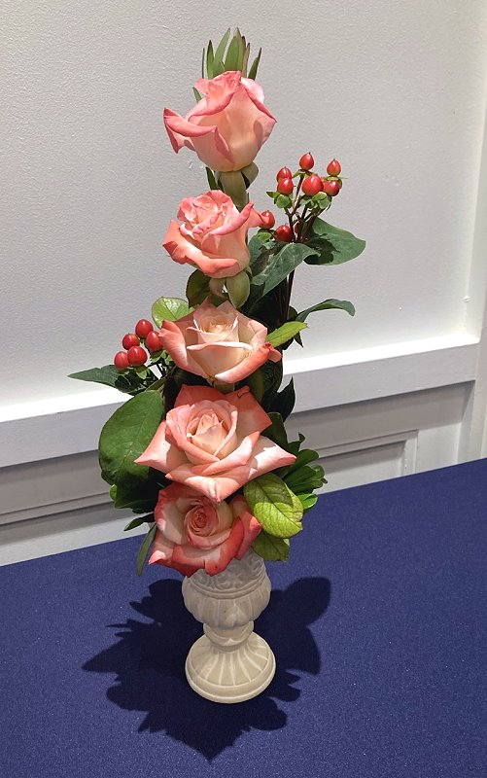
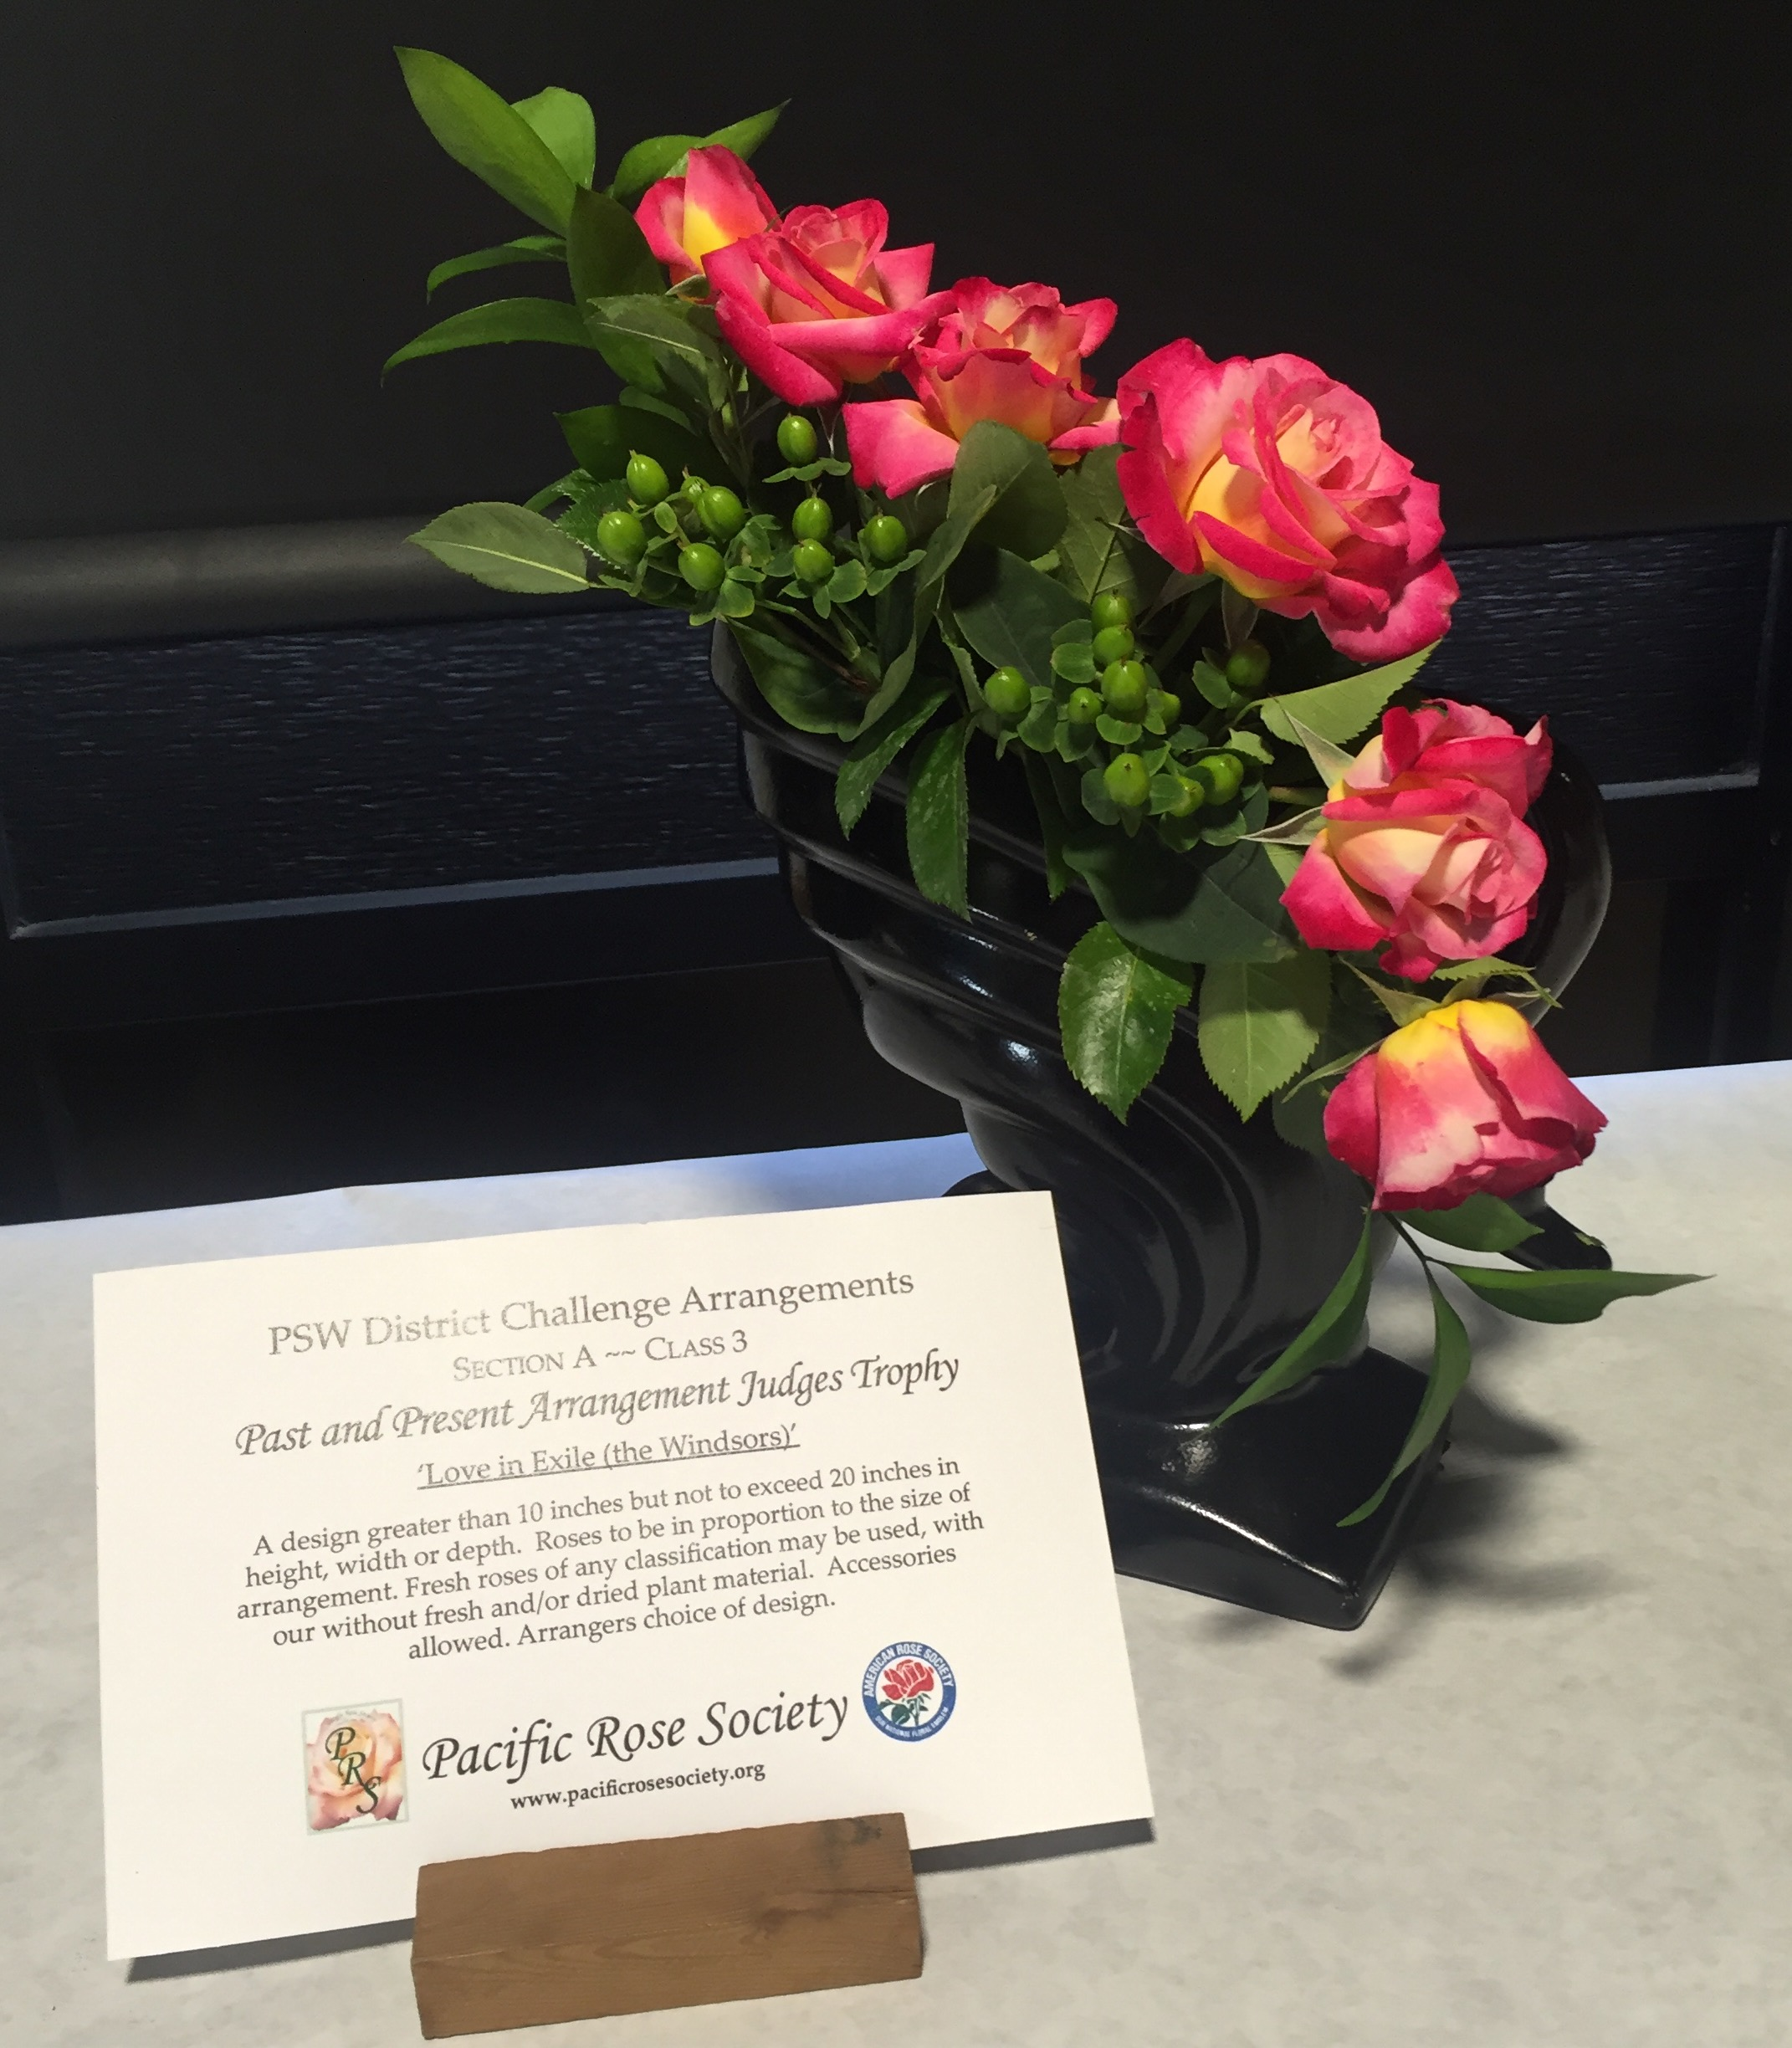
Traditional: Line Arrangements
Line should be clear and distinct
Can have vertical, horizontal or diagonal orientation
General rule of thumb for height: 1½ times the height of the vase

Slide 20
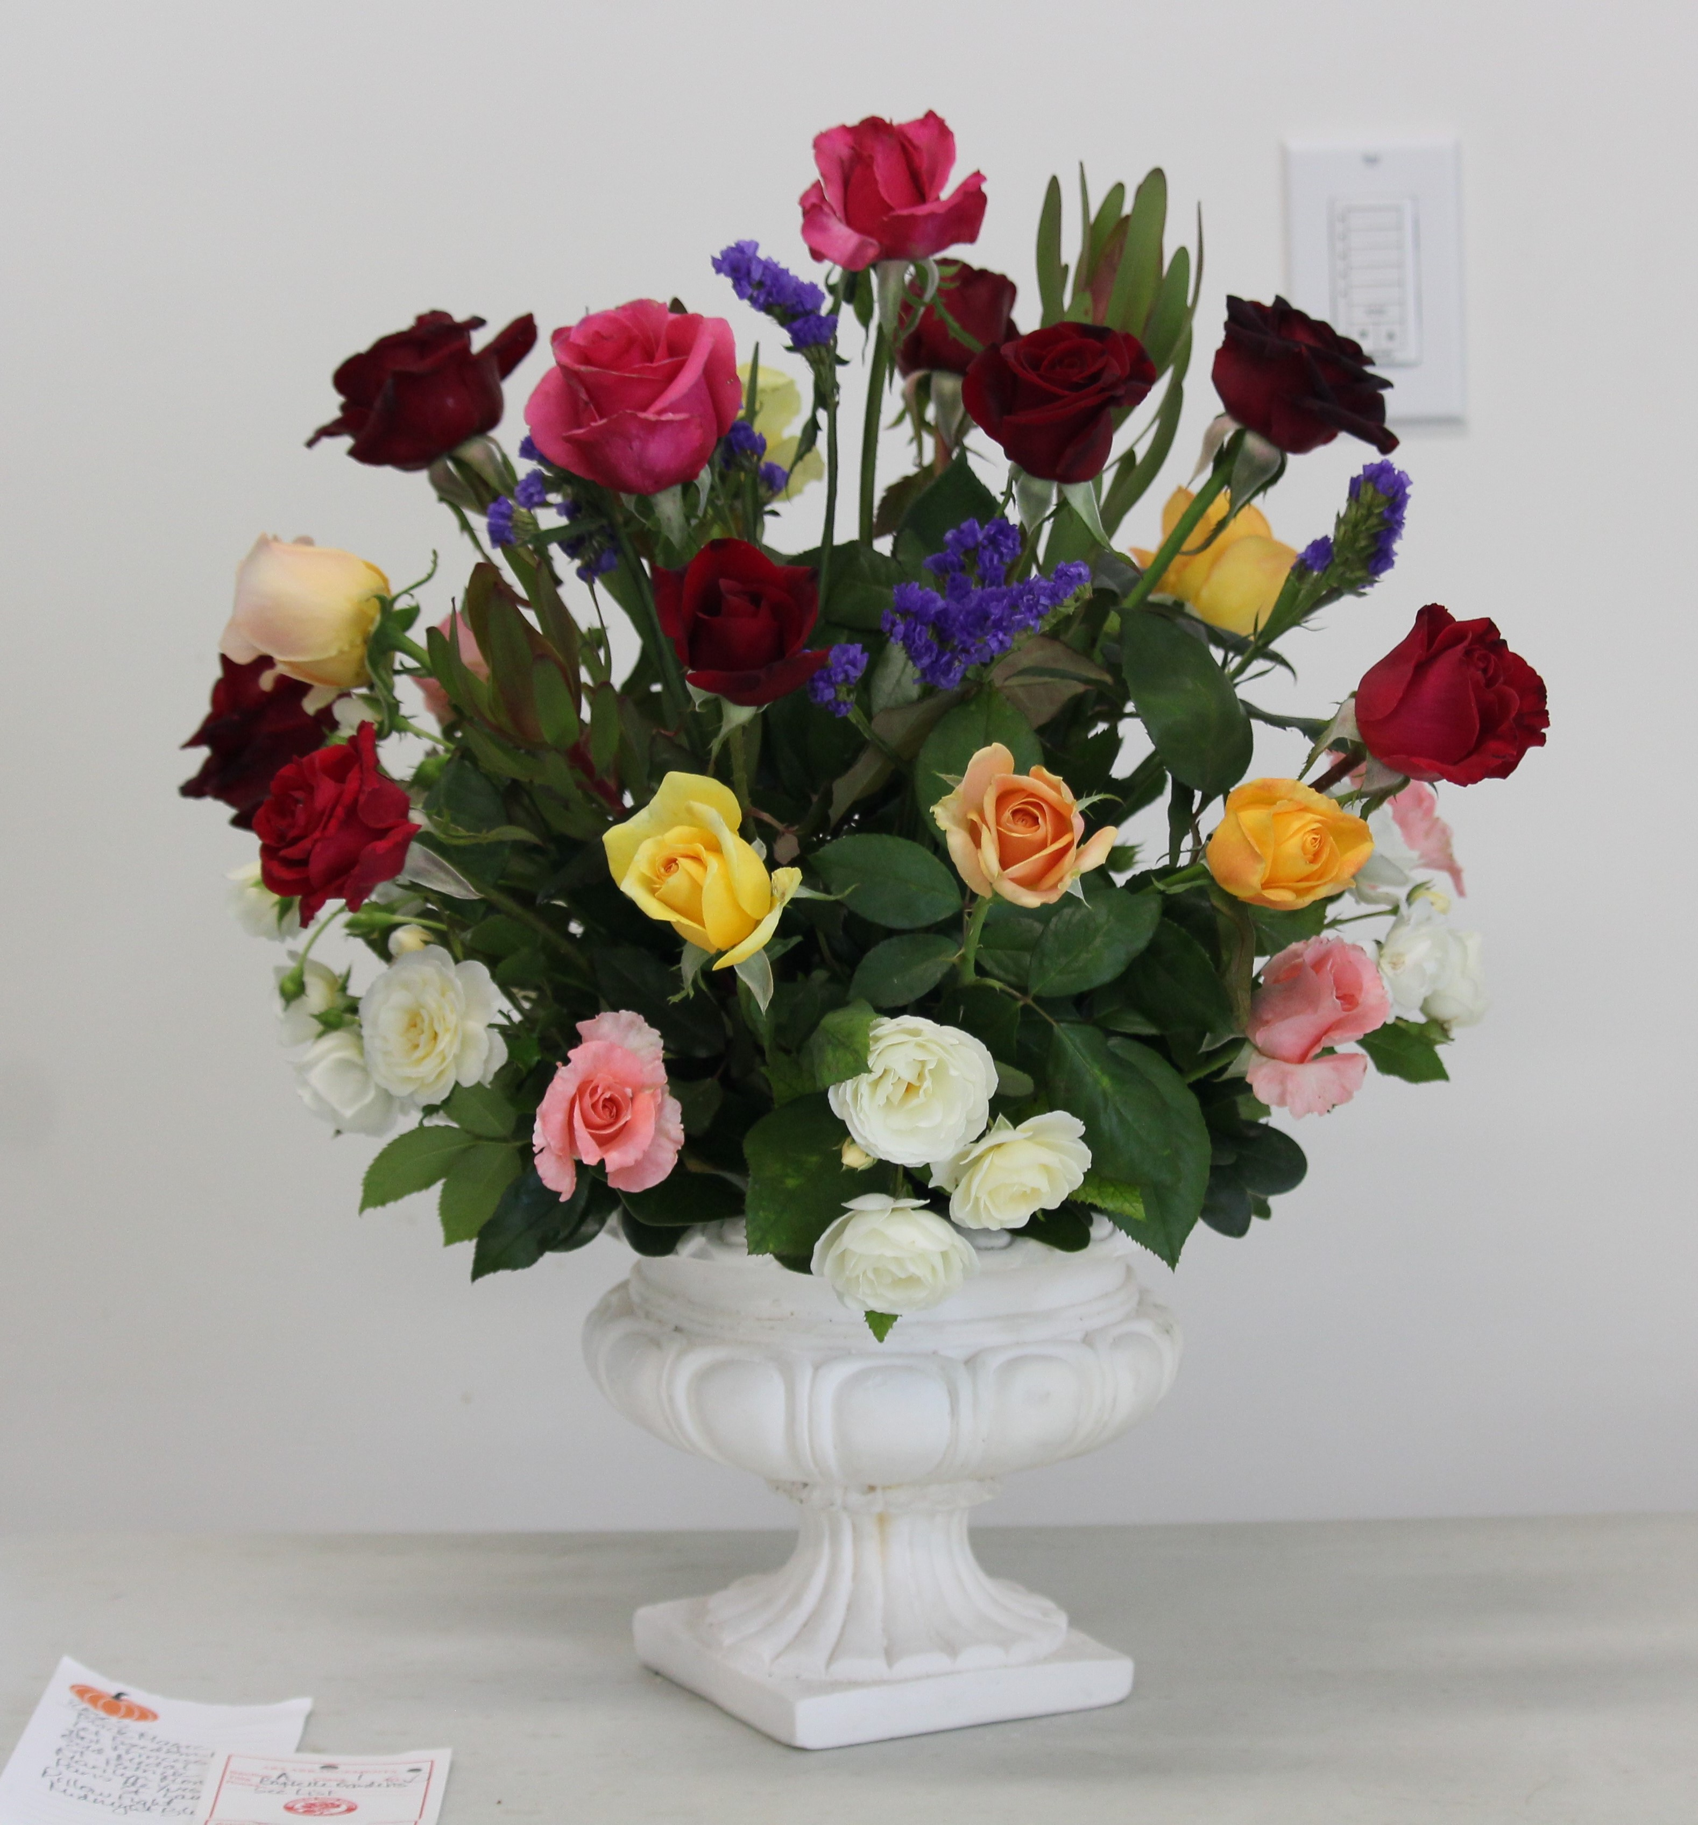
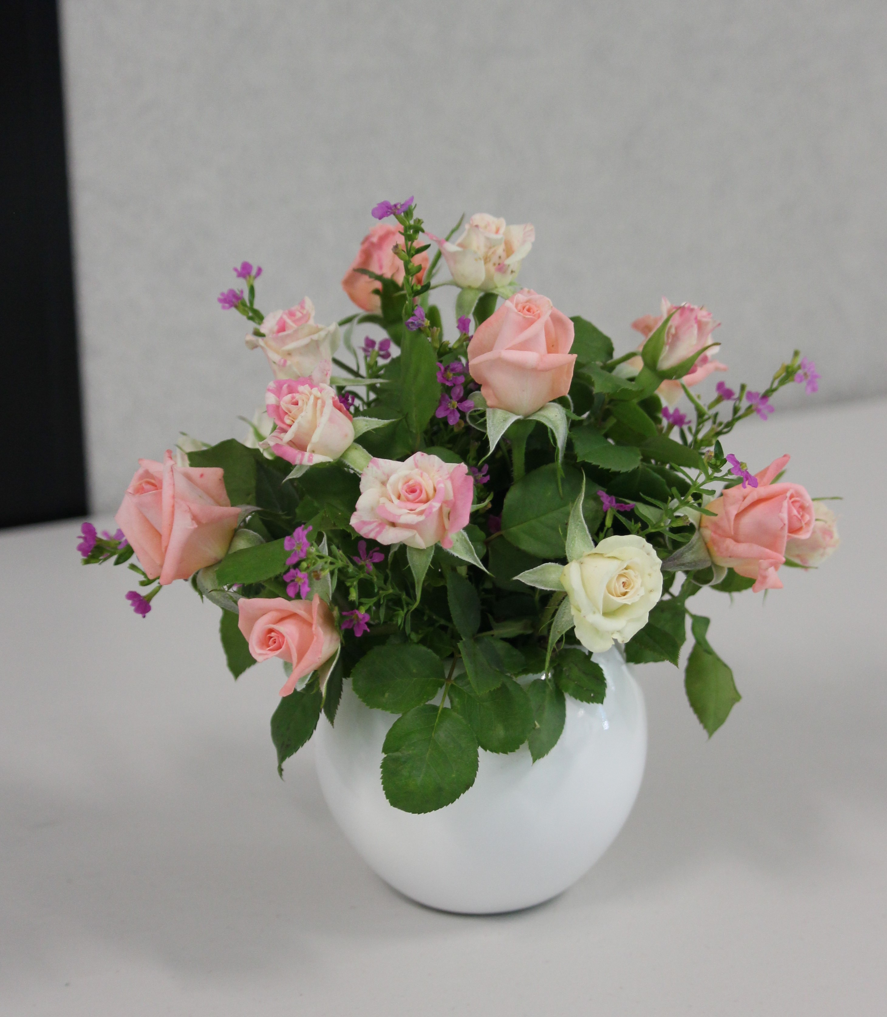
Traditional: Mass Arrangements
Usually most difficult to do (in terms of a rose show) because mass designs require many flowers
Symmetrical circular form
Alternate spacing with roses and filler material(s)

Slide 21
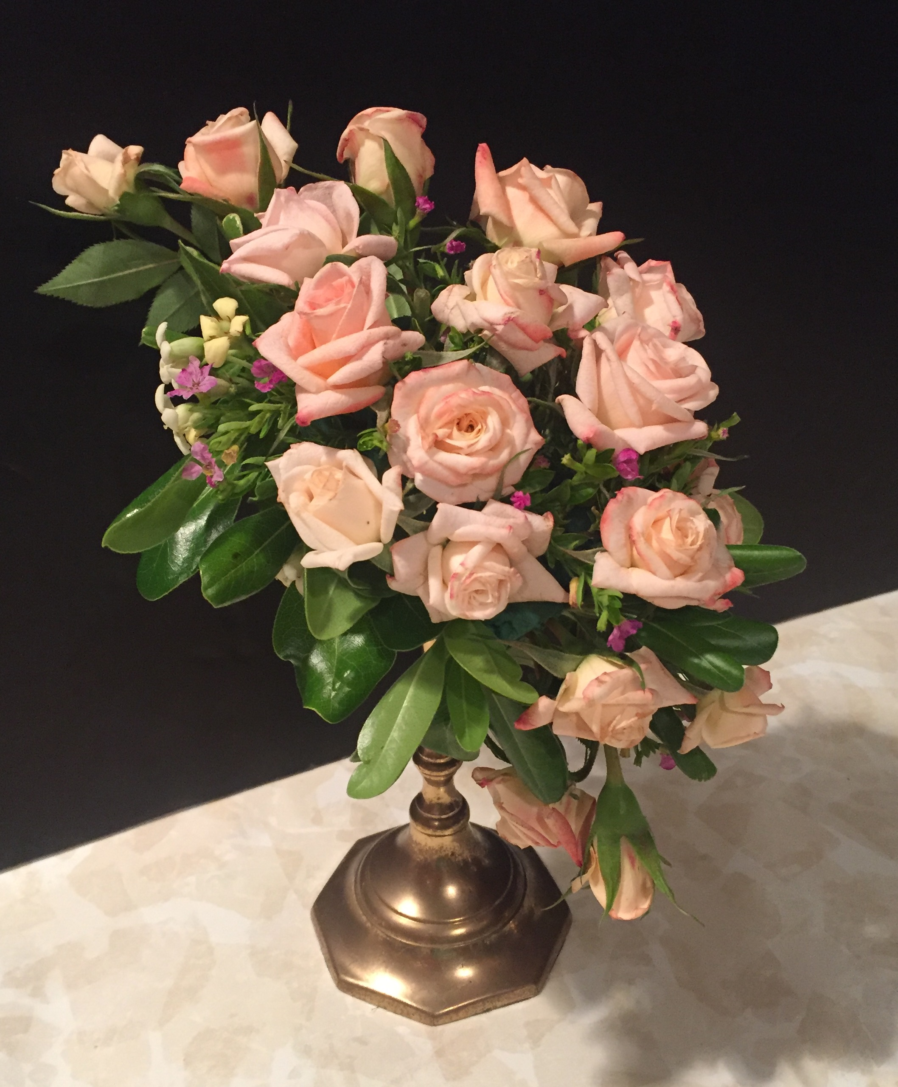
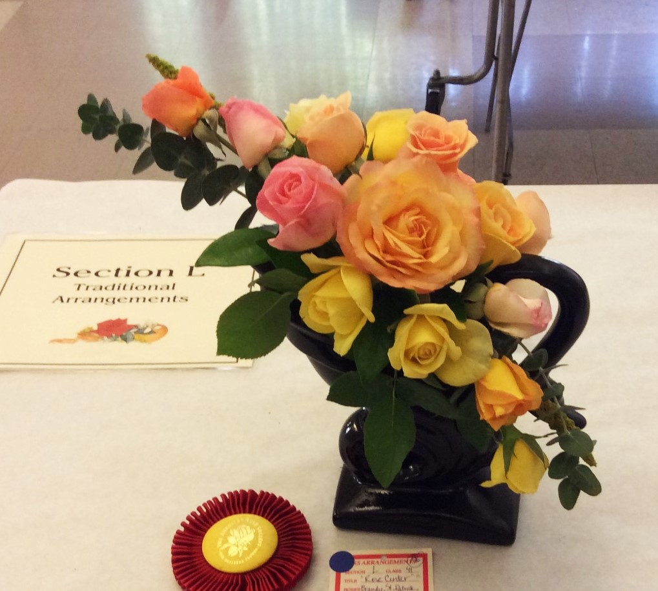
Traditional: Line-Mass Arrangements
Combine elements of line and mass designs
Focal point, line and balancing flowers
General rule of thumb for height: 1½ times the height of the vase

Slide 22
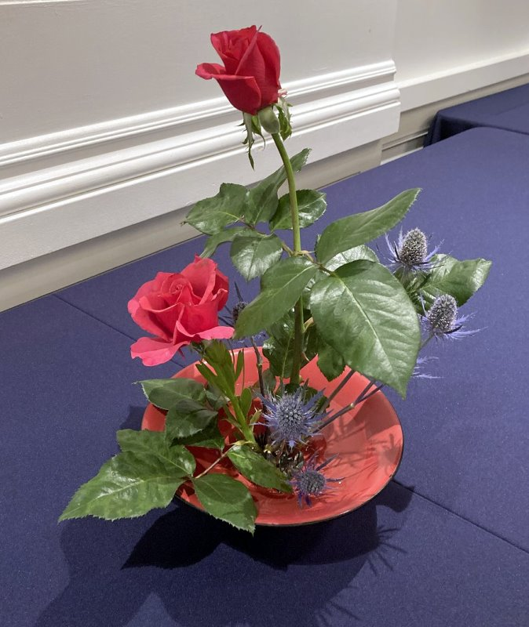
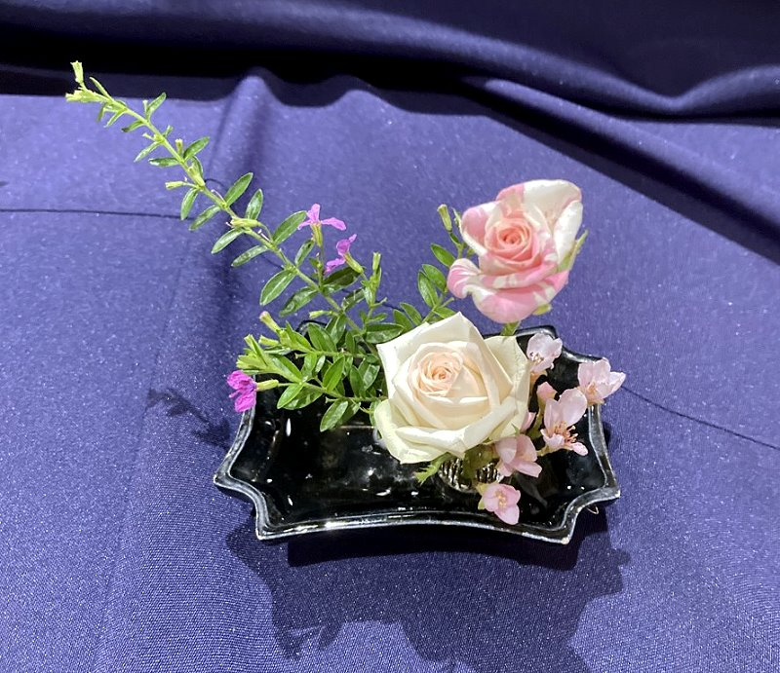
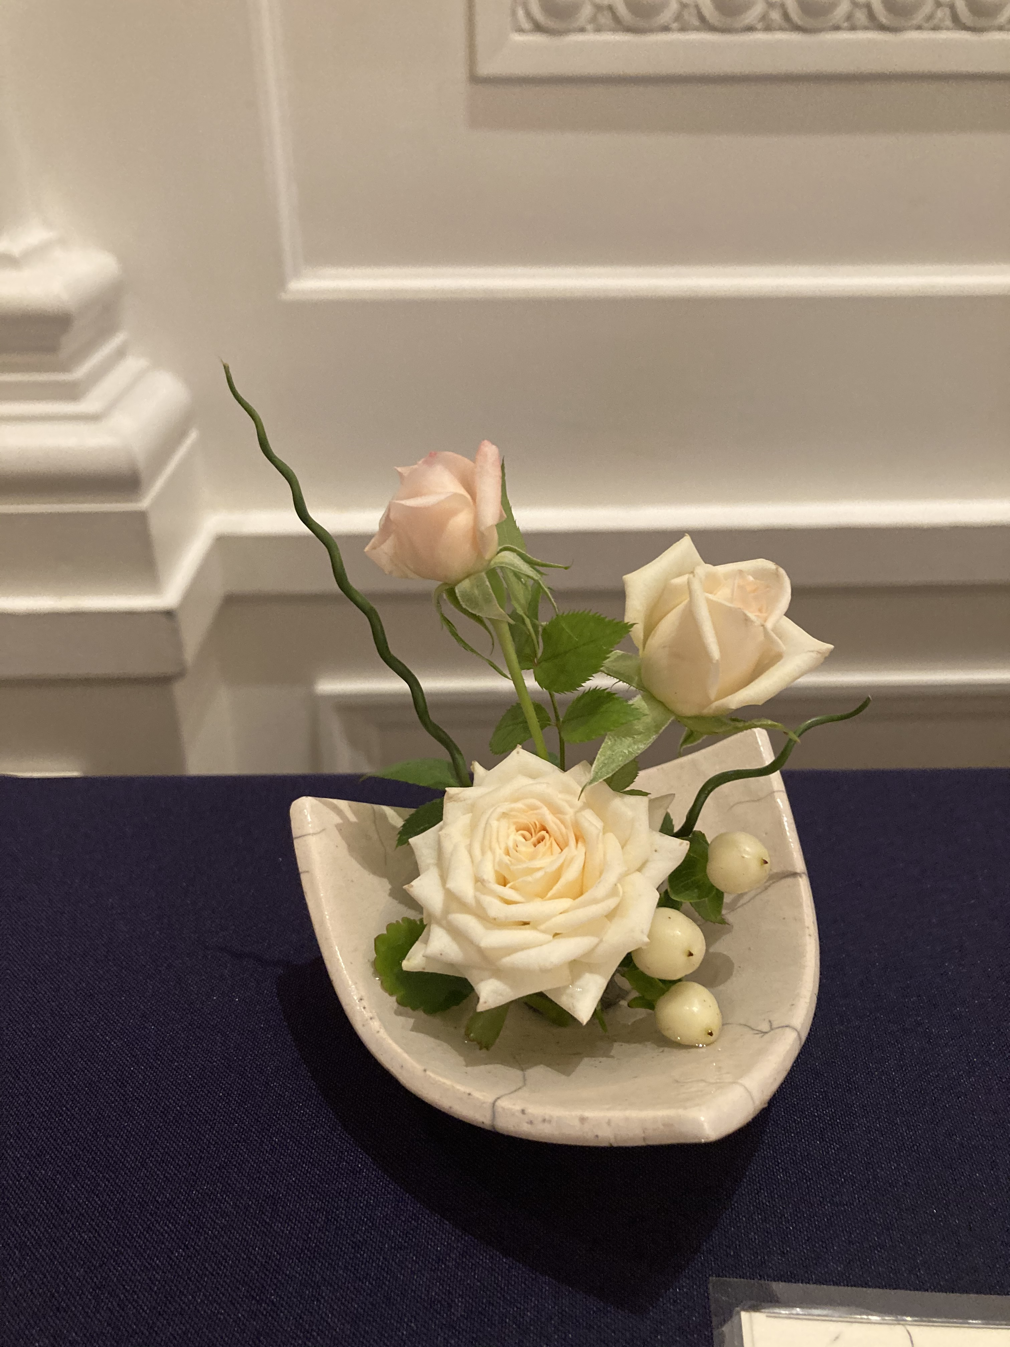
East Asian Style: Low With Water Showing
Pin frog usually best as anchor for flowers
Two or three flowers can make a beautiful arrangement
Simplicity with design and filler material; don’t overdo

Slide 23
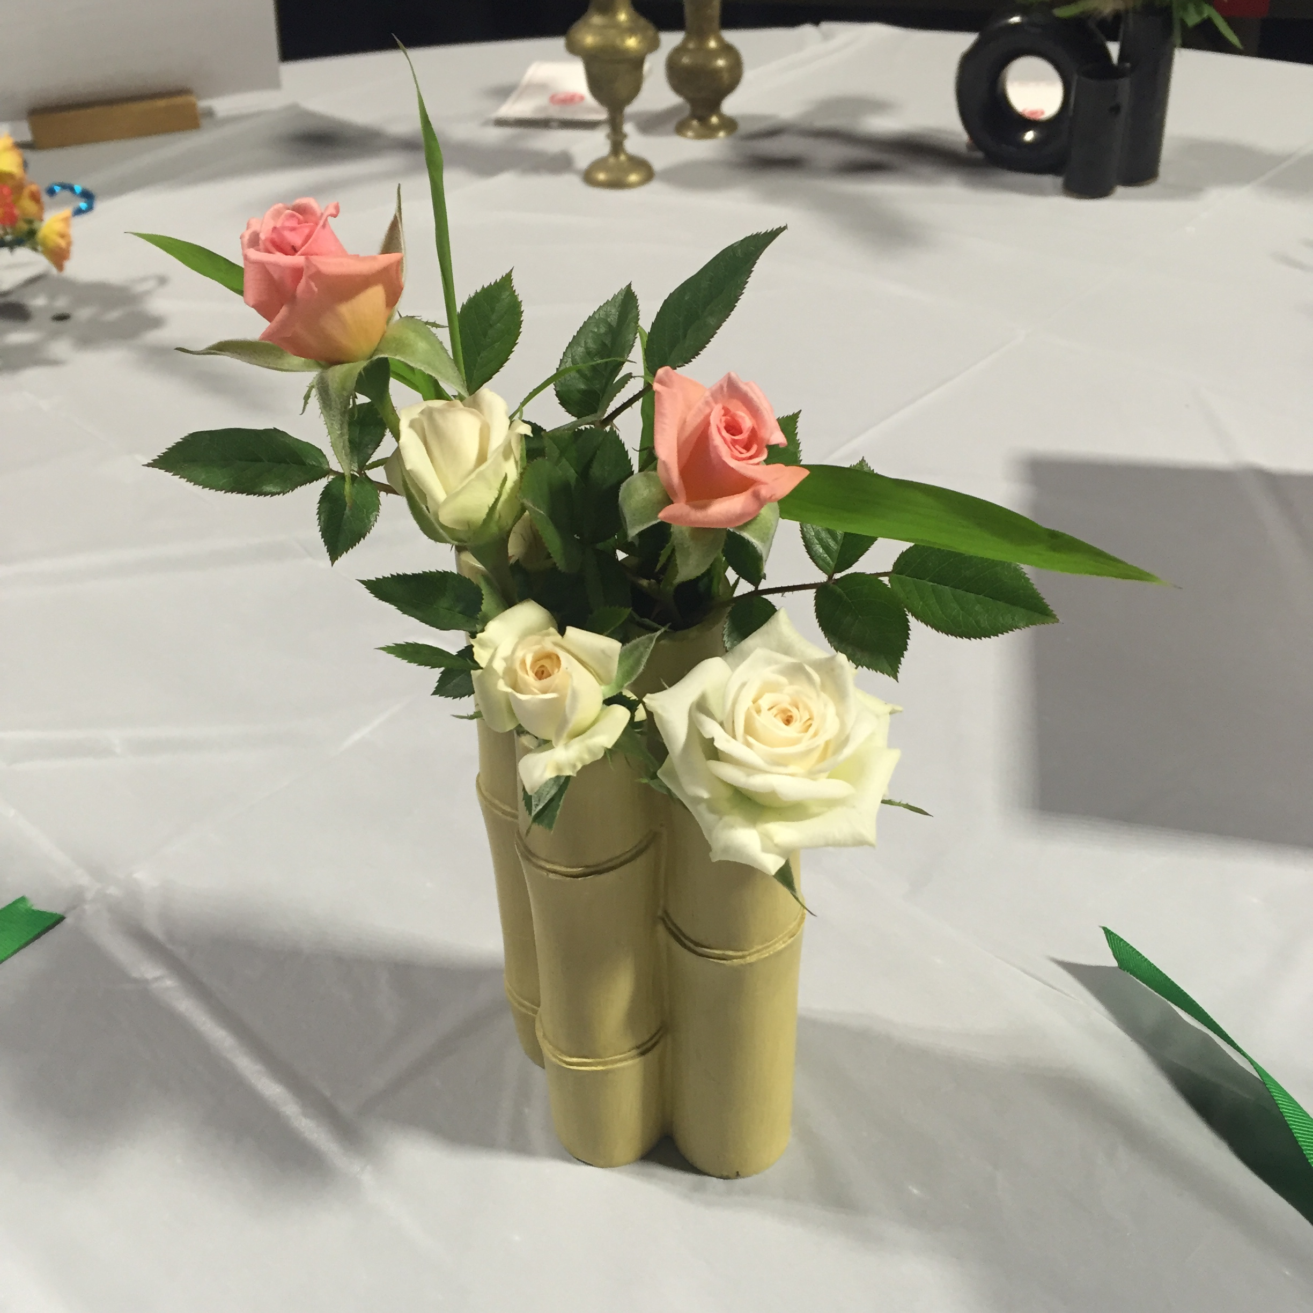
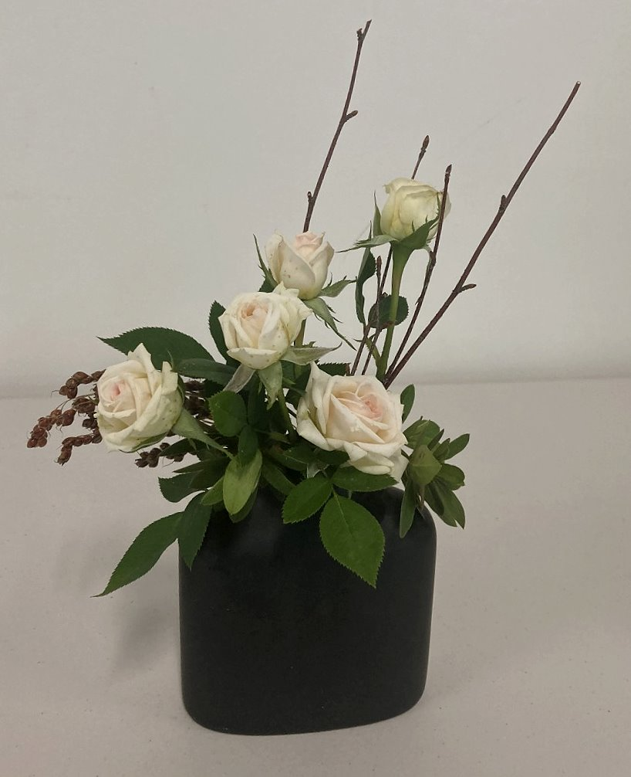
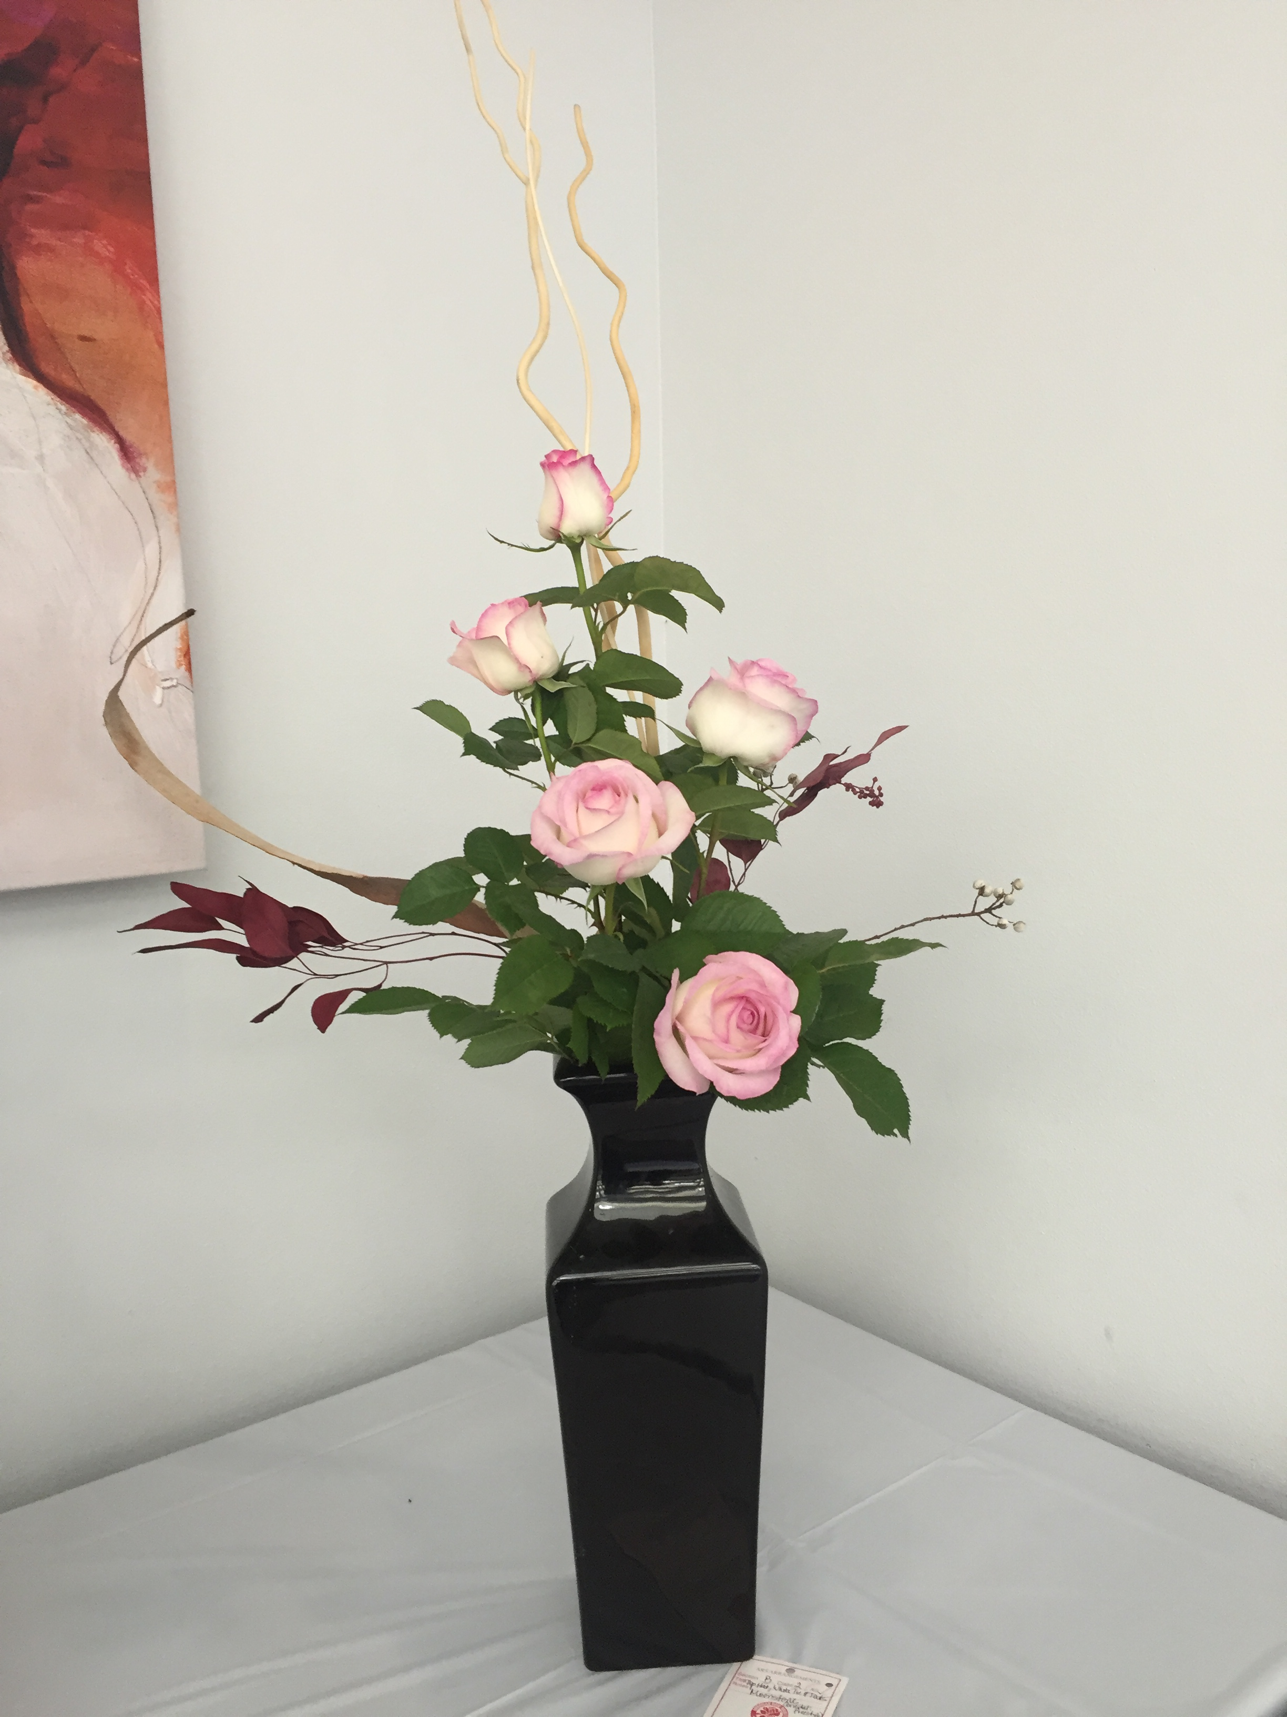
East Asian Style: Tall Container
General support from structure of vase/container
Smaller, narrow openings allow for arrangement w/out additional support
For miniature arrangements, pay attention to height requirements and proportionality of roses

Slide 24
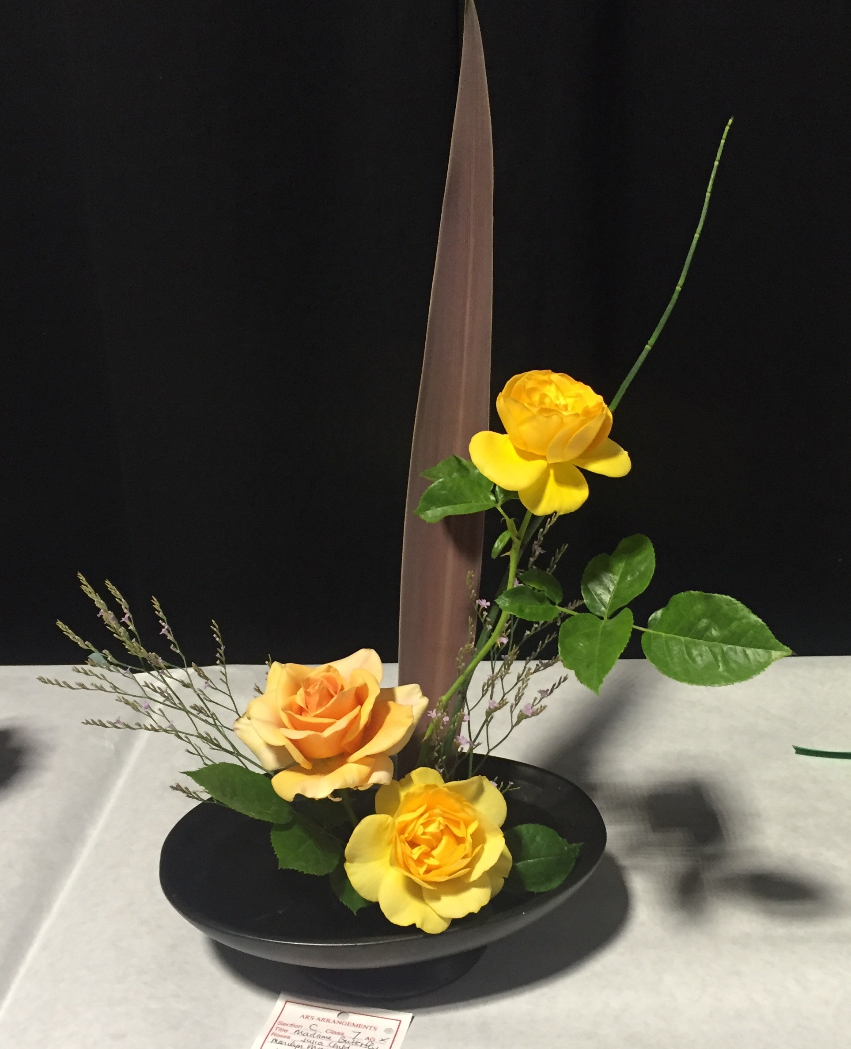
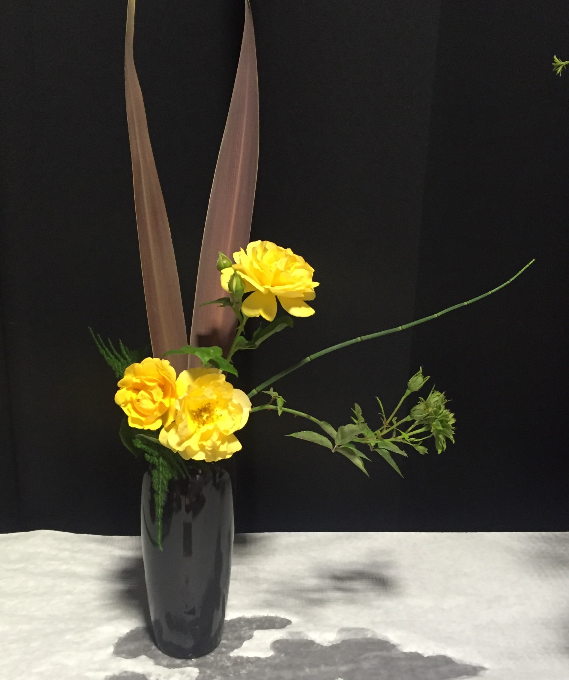
East Asian Style: Comparison of Styles
Arrangements by Kathy Monge
Left – Low with water showing; Right – Similar flowers in tall container
Other category – freestyle – has slightly more freedom in arrangement style and composition (not often on show schedule)

Slide 25
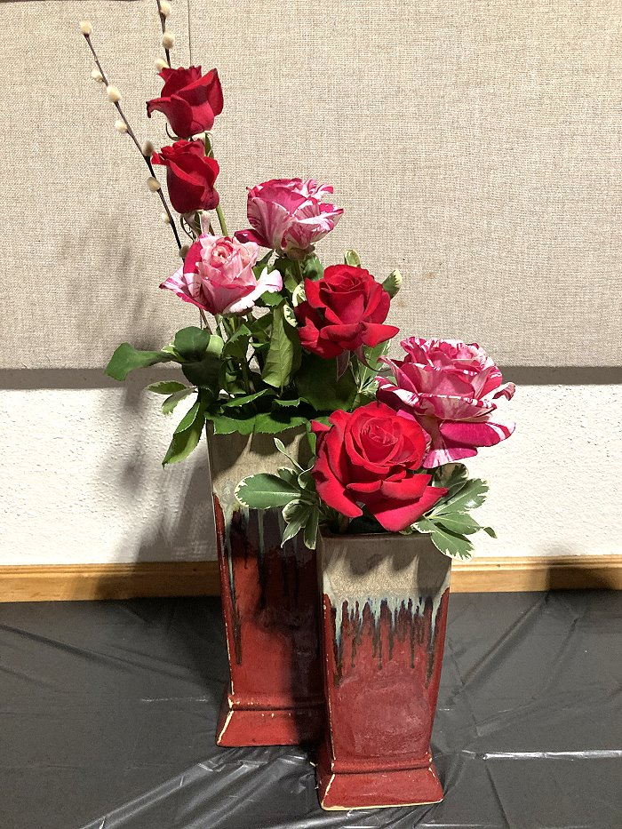
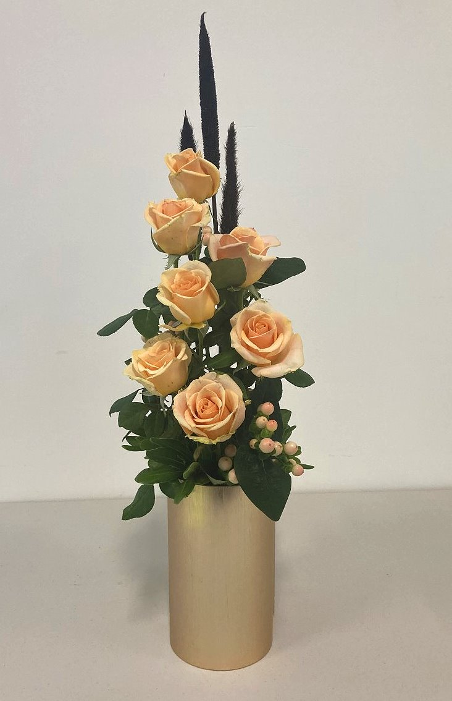
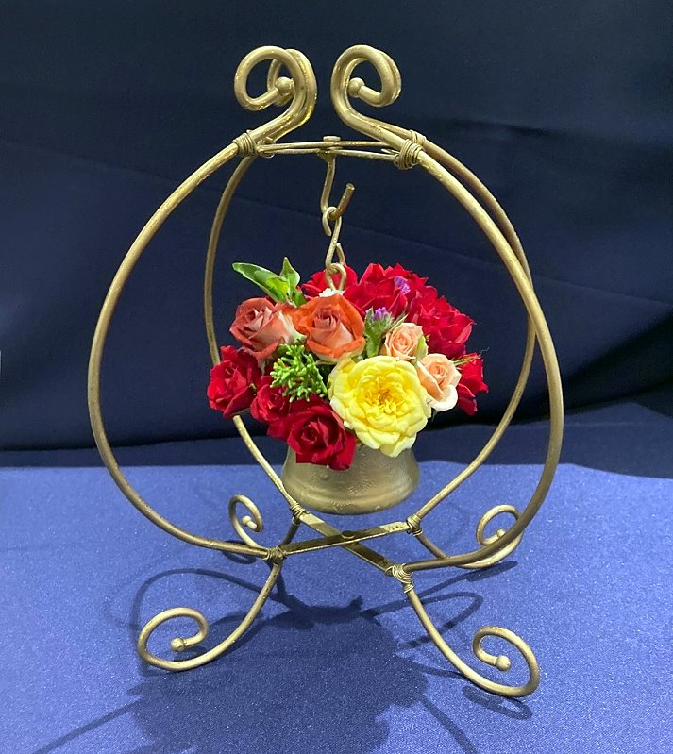
Modern Arrangements: Varied Designs
Design is usually specified in program. Can be hanging/suspended, underwater, cylindrical or open to interpretation by the arranger
Most freedom of design in modern category
Wide variety of design options

Slide 26
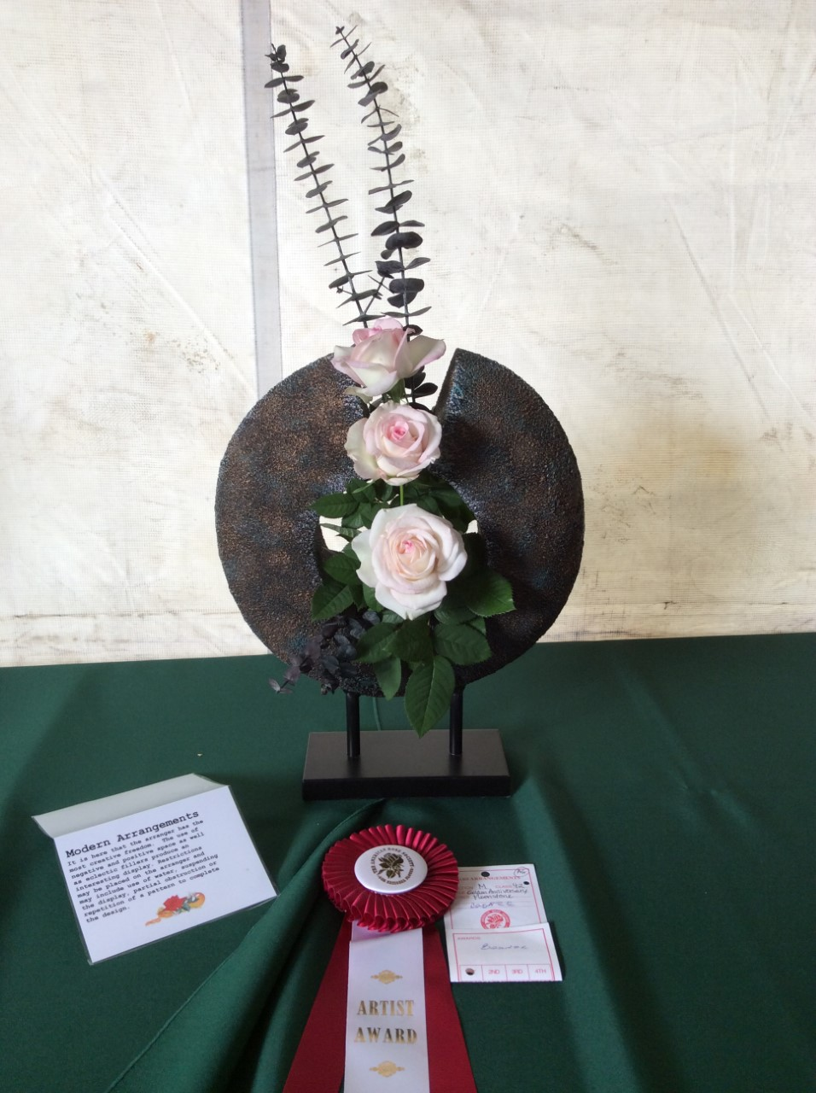
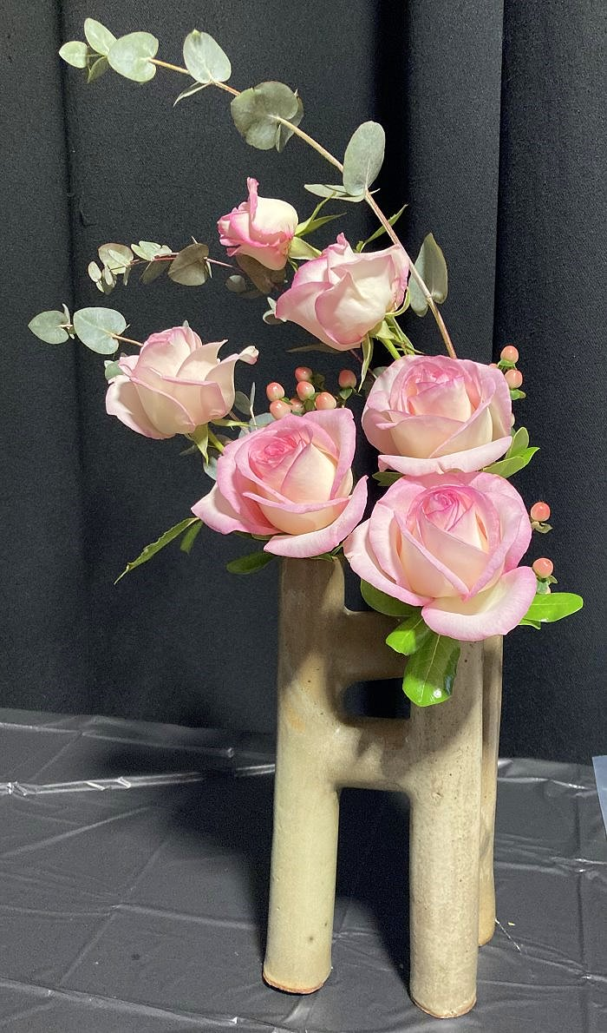
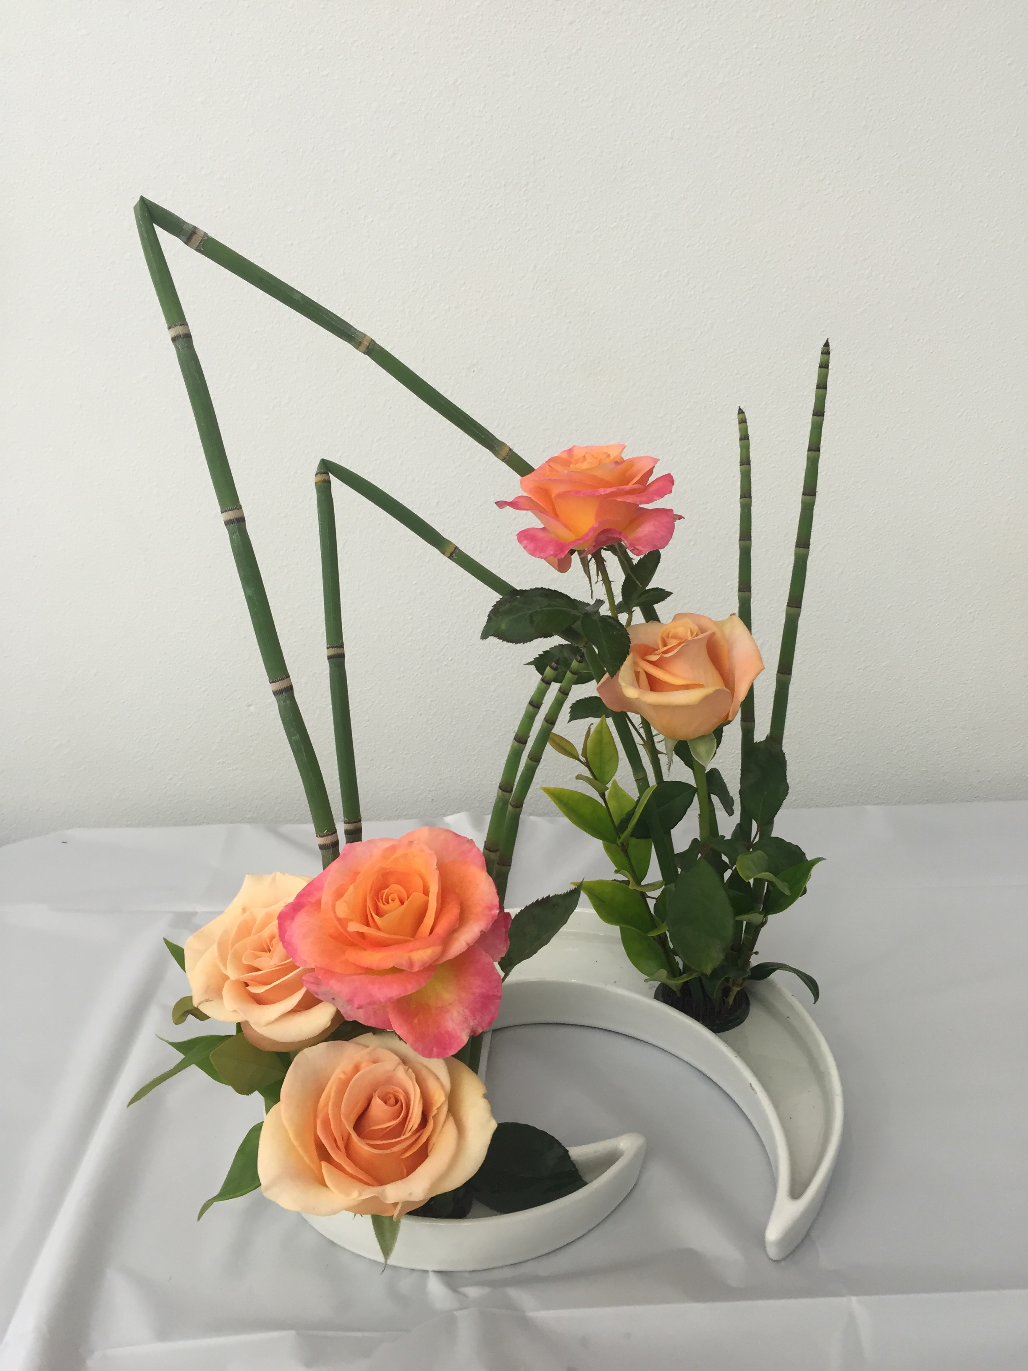
Modern Arrangements: More Designs

Slide 27
Practice Making an Arrangement
Look at your roses (or other flowers) and decide how many you have available, what type and what stage of bloom
Pick an arrangement style appropriate for the roses/flowers you have
Pick a container (Great sources for containers include your own shelves, stores like Home Goods, and even thrift shops and garage sales). A good source of Ikebana materials and containers is Little Tokyo in downtown Los Angeles (and online)
Pick your support mechanism, usually floral foam or a pin frog
If using floral foam, soak foam in water first without pressing down, flip over after a few minutes so water absorbs evenly. Consider adding a couple of packets of floral preservative to the water. Foam can be cut to size with a knife.
Position support in vase/container and begin making an arrangement. If necessary, gently pull out and reinsert flower(s) to reposition.
Finish by checking that floral foam is covered/not visible. Insert added greenery to cover open spots if necessary.

Slide 28
You’ve Practiced . . . Now What?
Take a photo or make an arrangement for yourself
Take a photo or make an arrangement or product for someone else.
Rose shows in fall – Orange County Rose Society rose show in October and possibly Coastal Rose Society/San Diego Rose Society show in Carlsbad
Take more pictures and practice making new arrangements with next blooms
Try to enter at least one photo and one arrangement at a rose show. Judges usually offer comments on entry tags, and they are one of best sources for input and feedback.
Please enter your photos and arrangements at the Orange County Rose Society rose show in October at the Nixon Presidential Library and Museum in Yorba Linda. Novice categories are available.

Slide 29
More Examples and Things to Consider
Visit the OCRS Facebook page at http://www.facebook.com/orangecountyrosesociety
Photo album of members’ favorite roses and award-winning arrangements
ARS 2024 Roses Wall Calendar Contest
Limit of 5 submissions per member; digital photographs only
Deadline for entry is June 15; see details in ARS American Rose magazine
ARS Annual Photo Contest
Classes include novice, experienced, masters and juniors
Deadline for entry is November 5; see details in ARS American Rose magazine
Photos displayed in American Rose magazine throughout the year

Slide 30
Thank You!
And remember:
Practice
Practice
Practice . . .
(And then practice some more!)

